Slide 1
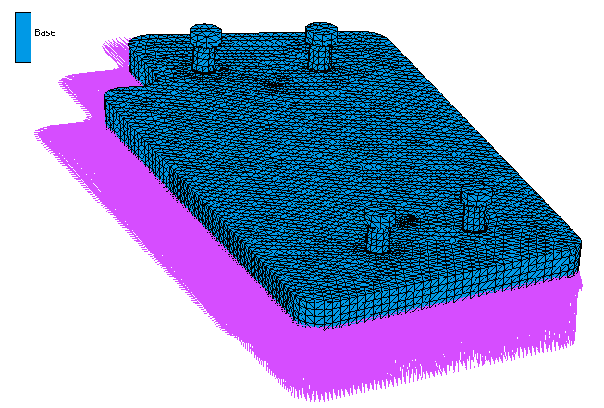
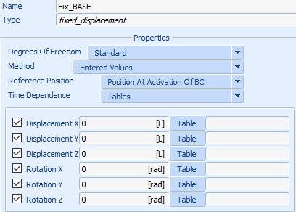
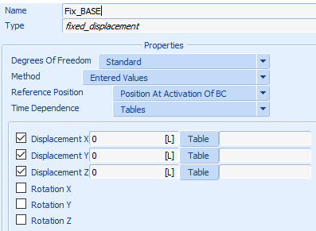
Hello, I have a problem about Boundary conditions setting in MARC.
I fixed 6 DOF in .mud file ➔ Then we submitted, MARC created .dat file
But I checked and found that the .dat file that MARC automatically removed the constraint of rotation (last 3 DOF), while still keeping the constraint of displacement (the first 3 DOF)
I am now using three version of MARC and the problem appeared in all three version.
Could you please explain and give me the solution, thank you
Fix from file .mud
Fix from file .dat

