Slide 1
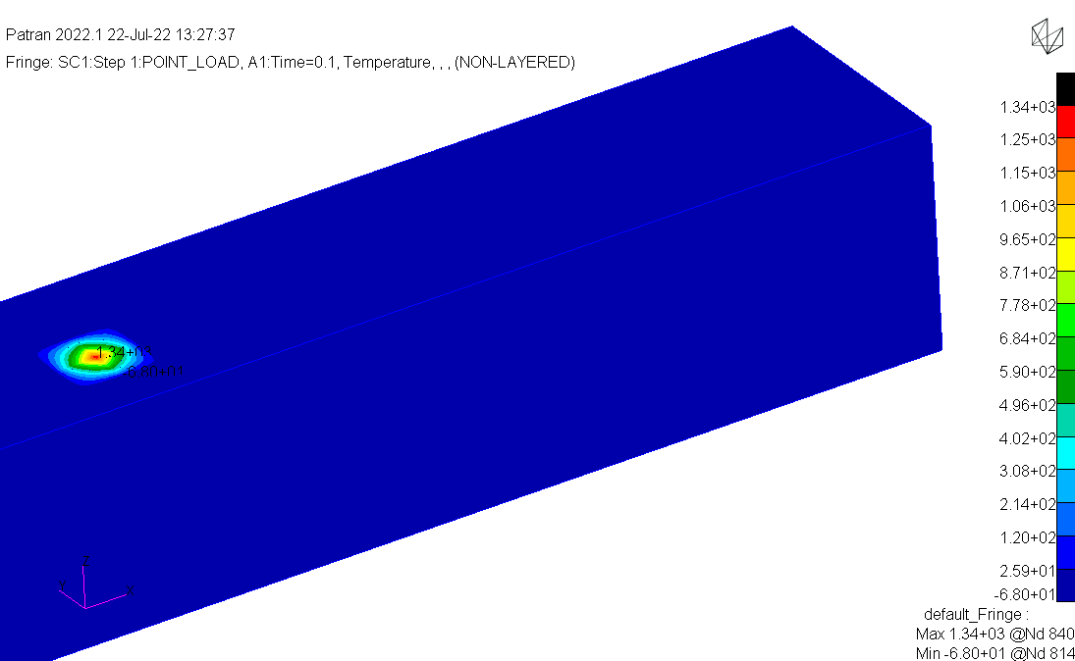
Epoxy for thermal conductivity

Slide 2
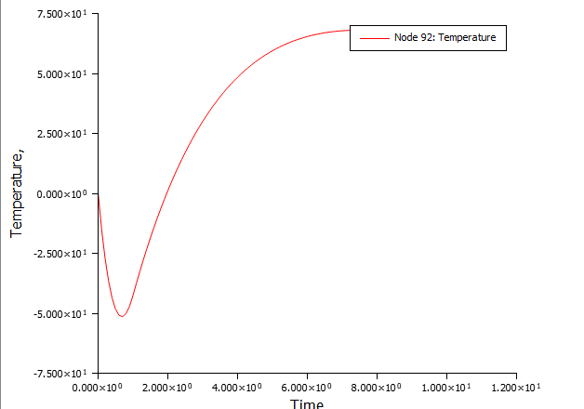
Point load moved_400_epoxy_point.bdf

Slide 3
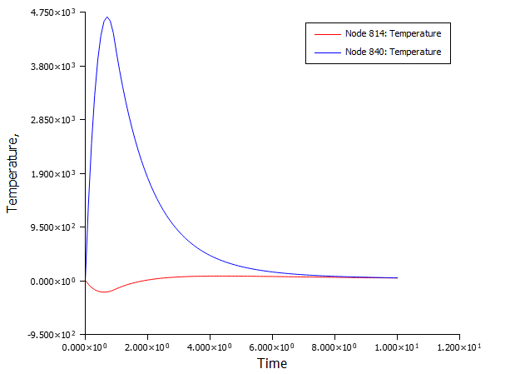
Plot the peak temperature and the minimum temperature

Slide 4
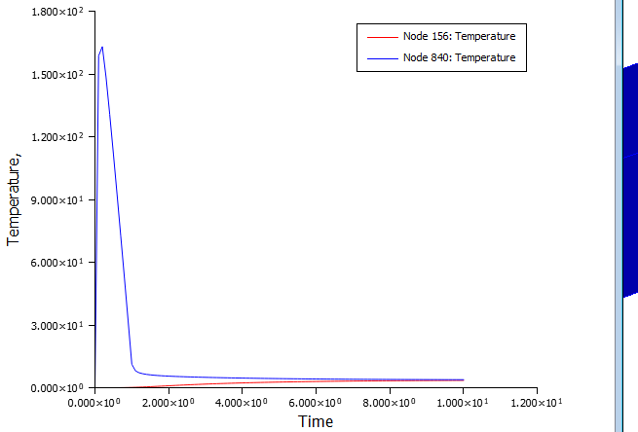
Increase thermal conductivity by a factor of 100

Slide 5
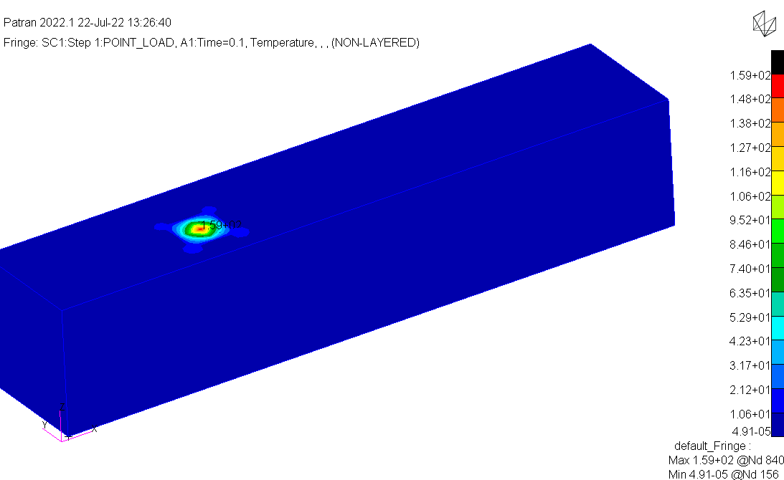
Now the temperature do not dip
What this means is that you need mesh refinement

