Slide 1
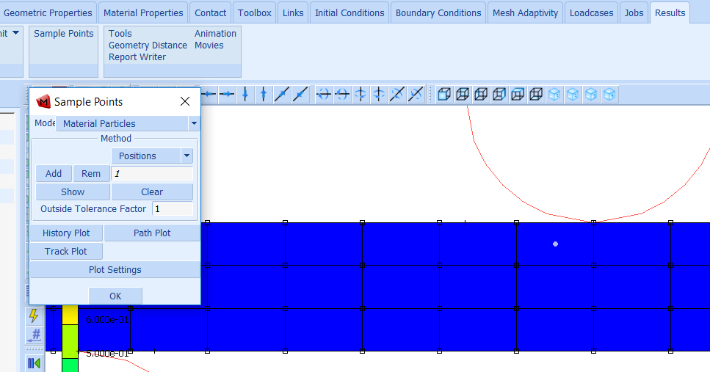
Post result file
Click on Sample Points
Add sample points by entering their coordinates

Slide 2
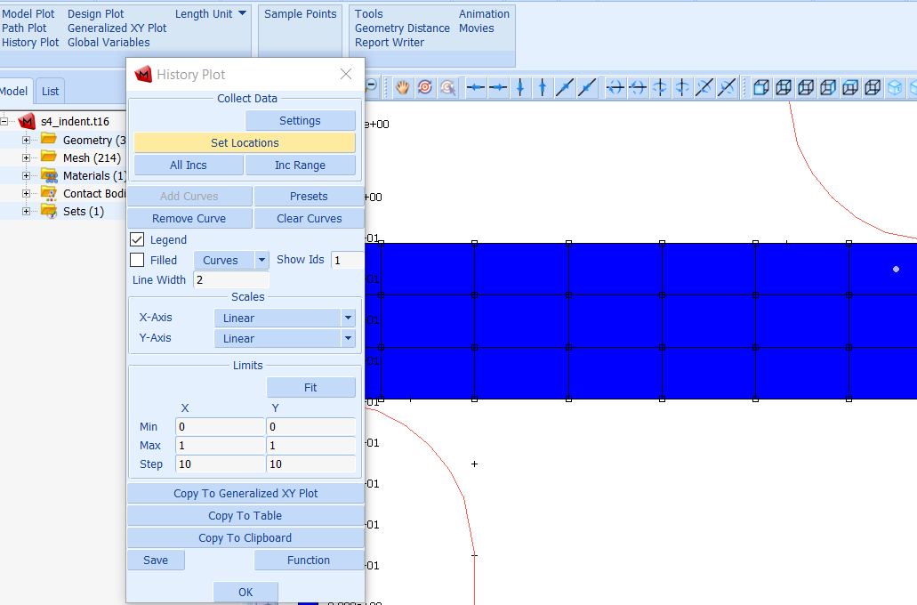
Click on History Plot
Click on Set Locations
Select sample points, click right mouse button to end selection
Click on All Incs

Slide 3
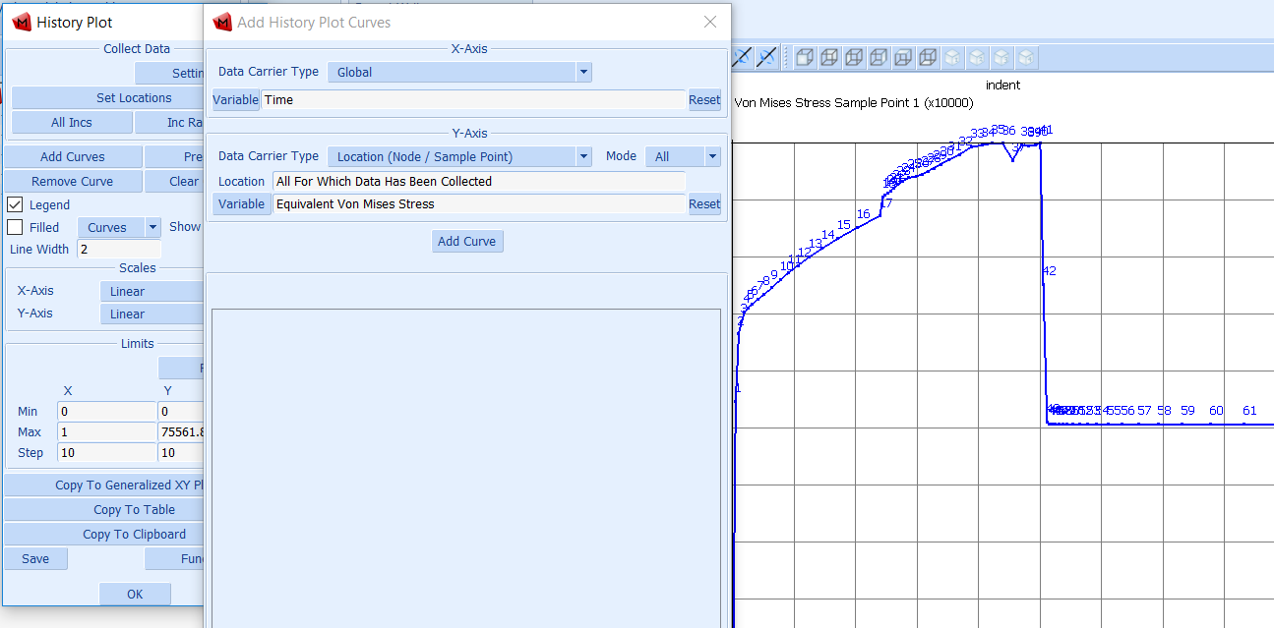
Click on Add Curves
Set Time as X-Axis
Select desired variable as Y-Axis
Click on Add Curve

