Slide 1
Automatic Fastener Script
larry.pearce@mscsoftware.com

Slide 2
This script is Perfect!
NO! NOT! NADA! m Hai! Ne! Nee! Non! Nein! Nahi! Lie! Nao! Net! Nej! Hayzr! And so on …
If you have problems or issues executing this script, I will be happy to help debug and correct …
Or, if you make additions or corrections to the script, please share with me ☺
~
~

Slide 3
Features
Automatically creates flexible fasteners between holes in 2D surfaces
Automatically finds 2D hole features
Fastener diameter is based on the hole diameter
Mating hole diameters must be the same within a tolerance
Optionally creates multi-Part fasteners, i.e., between more than 2 Parts
Note that the fastener is not continuous between the Parts. I may be able to correct this soon.
Optionally allows mating holes to be misaligned, i.e., imperfect CAD geometry
Hole connections can be rigid (RBE2) or compliant (RBE3)
Due to limitations in Hawk (or perhaps the programmer), the script does not currently support point-to-point connections

Slide 4
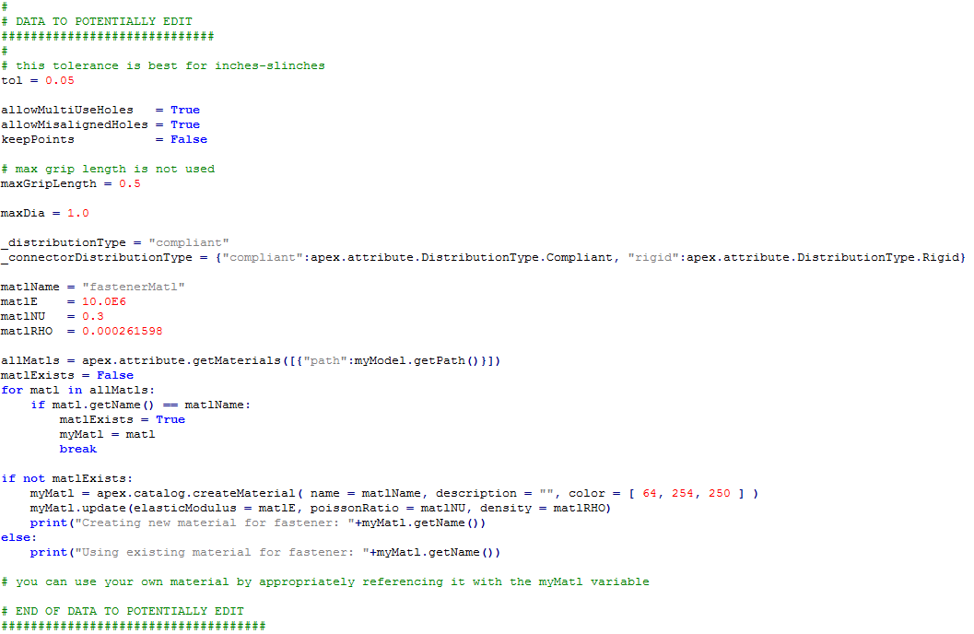
Optional script edits (see more on next slide)
maxDia no longer used

Slide 5
Optional script edits - details
For different unit systems or even model dimensions (big vs small), you may need to adjust the tolerance
0.05 seems to work well for inches and mm
allowMultiUseHoles
Set to True if you want to connect Part-to-Part-to-Part-to-<more here>
Note that the connections are not continuous between the Parts. I hope to address this soon.
allowMisalignedHoles
Set to False if the hole axes must be aligned within the tolerance value
keepPoints
Currently the code creates a Point at the center of each hole (I hope to not need to do this in the future)
Set to True if you want to keep these Points
maxDia
Do not create a fastener if the hole diameter is greater than this. Perhaps, I should also add a minimum diameter as well
_distributionType
Set to “compliant” or “rigid”
You can also edit the material to be used by the fasteners

Slide 6
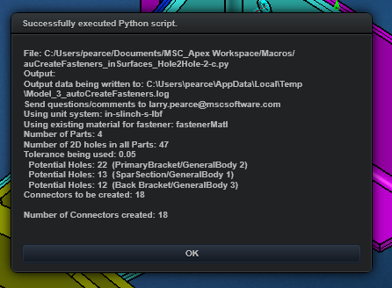
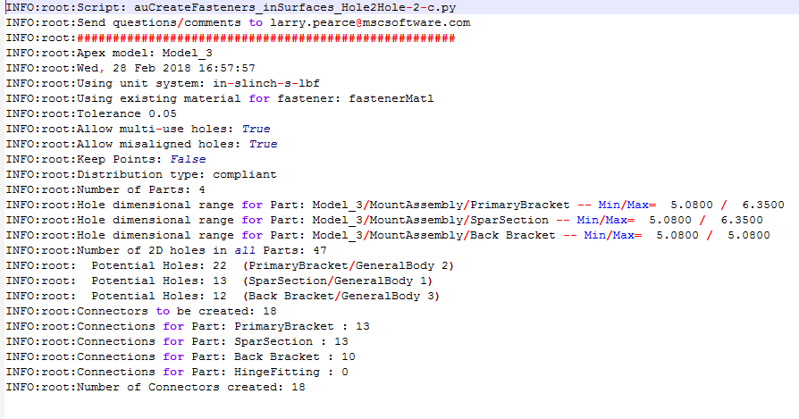
Script output
To the Apex script modal output form
To a log file
Will be in the user’s temporary folder
If unable to resolve temporary folder it will be in C:\
If unable to write to temporary folder or C:\ it will not be output at all
Filename will be:
<Apex Model>_autoCreateFasteners.log

Slide 7
Limitation
Holes must have only 1 edge
I hope to remove this limitation soon
Ok!
Ok!
NOT Ok!

Slide 8
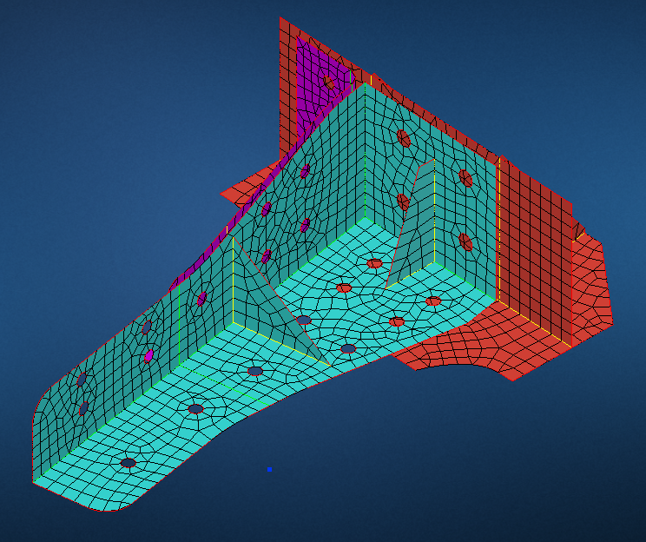
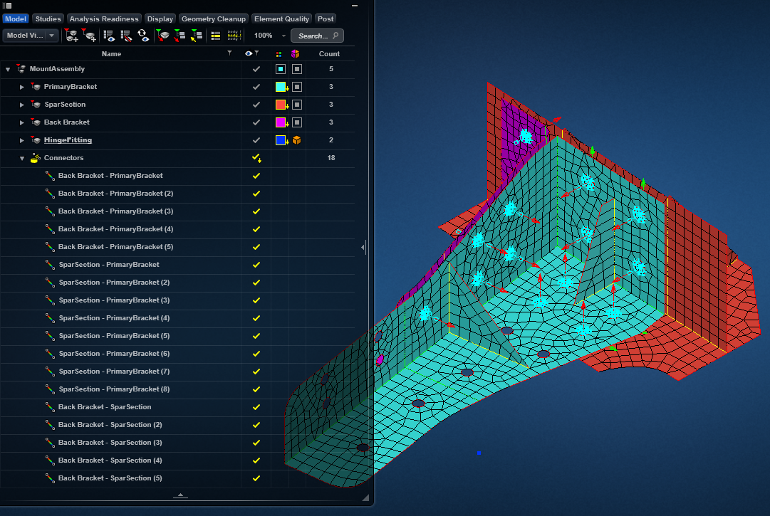
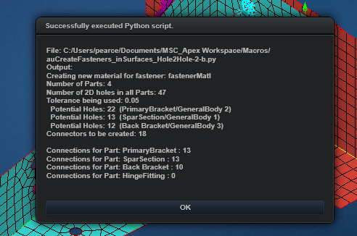
MountAssembly_wMidsurfaces.X_T

Slide 9
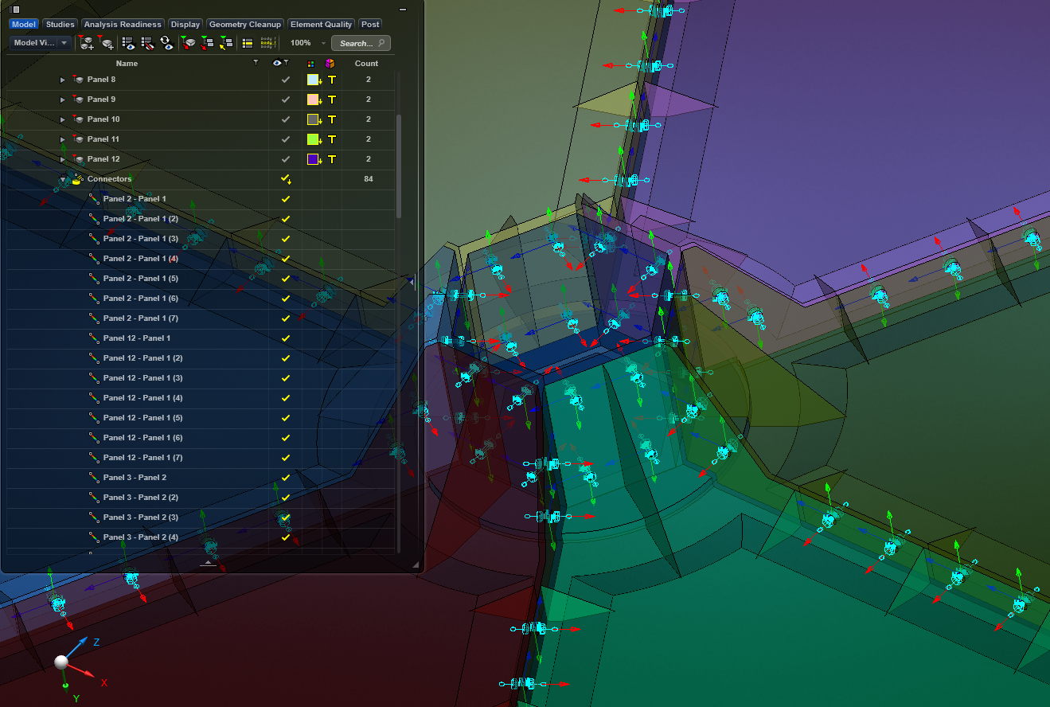
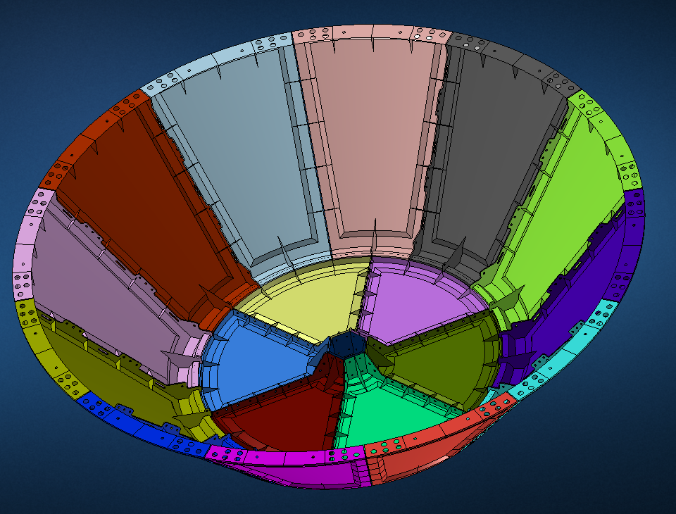
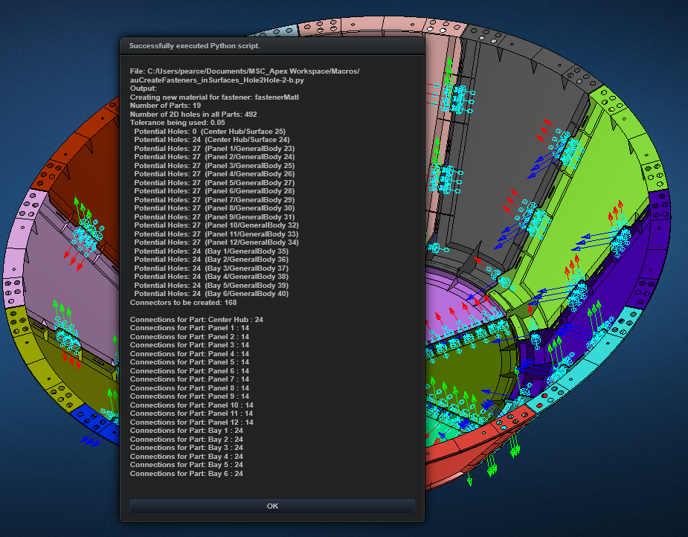
Crew Module with ms-2.X_T

Slide 10
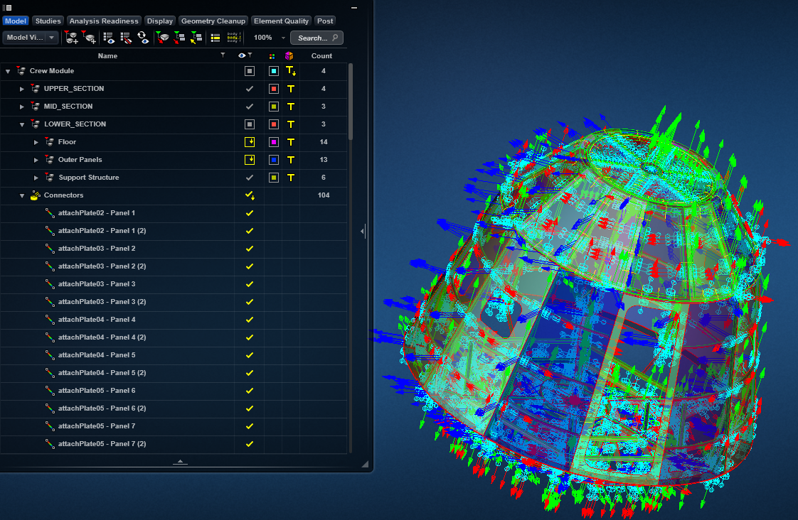
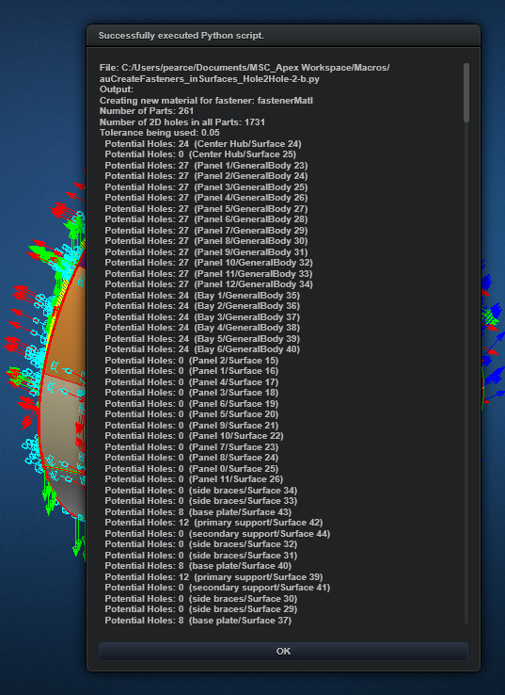
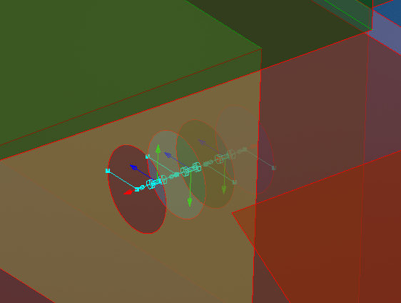
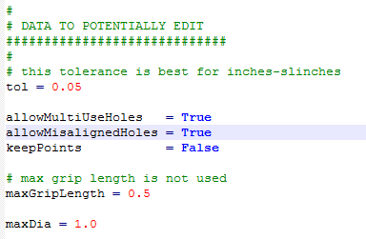
Crew Module-Whole.X_T
Connecting 3 Parts

Slide 11
Connections between more than 2 Parts
I hope to be able to create a continuous fastener soon
Unexploded view
Duplicate nodes and RBEs
Exploded view

Slide 12
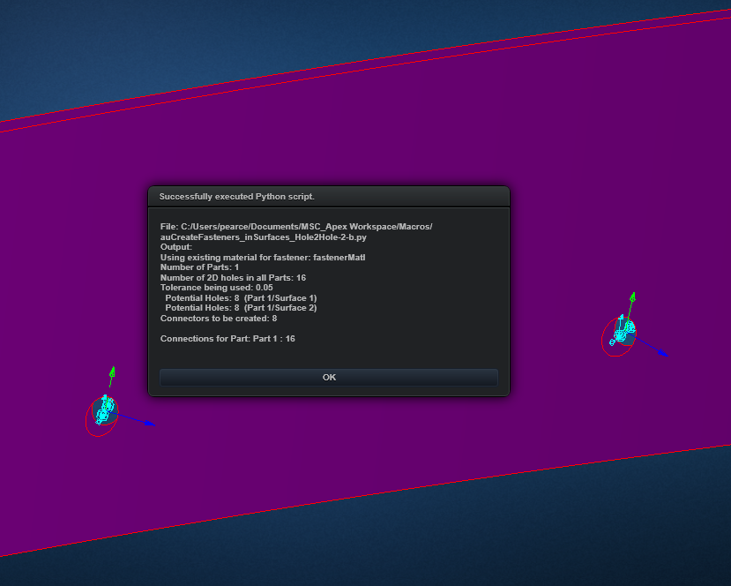
misAlignedHoles.X_T
If allowMisalignedHoles = False, the fasteners are not created

Slide 13
Coming Attractions …
Point-to-point connections
Requires ability to get nodes close to seed points
May require ability to macro record seed point creation
Continuous fastener multi-Part connections
I may be able to do this in Hawk. Stay tuned …
CBUSH connections that support Huth or other fastener stiffness calculations
I may be able to do this in Hawk. Stay tuned …
Support for holes with more than 1 edge
With imagination, I may be able to do this in Hawk. Stay tuned …
If we could get geometry associated to a feature this would be easy

