Slide 1
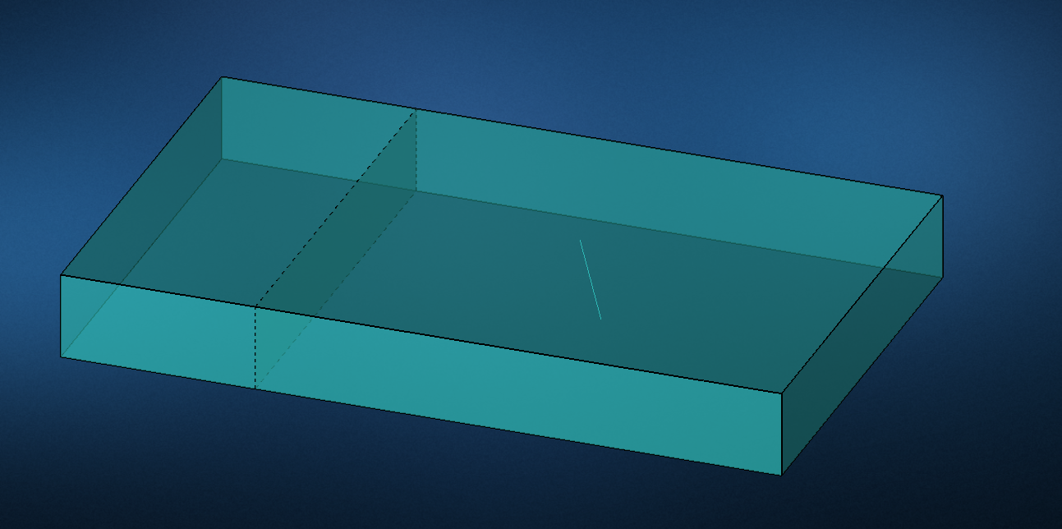
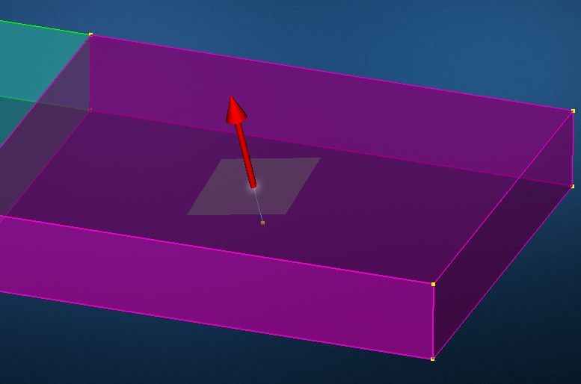
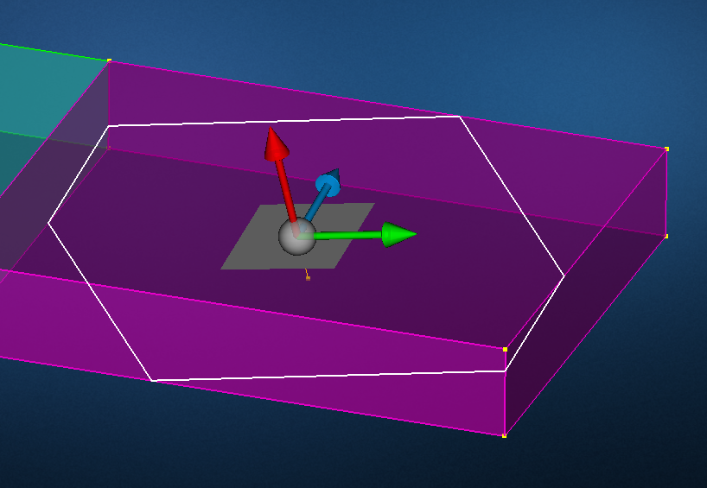
Solid with curve representing the bolt axis
In the split tool, pick on the curve to create a cutting plane

Slide 2
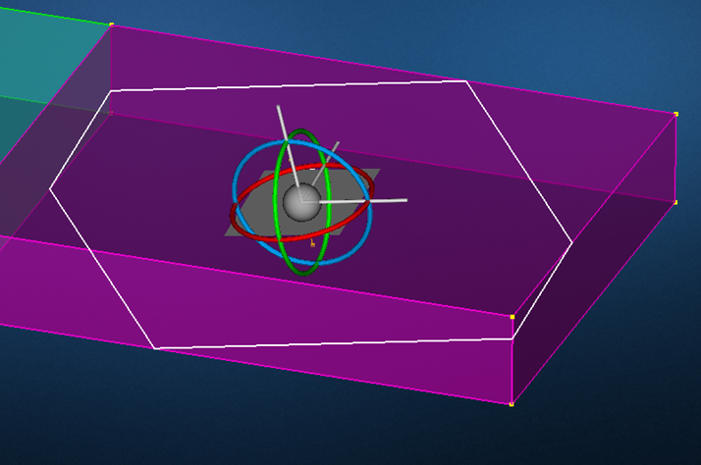
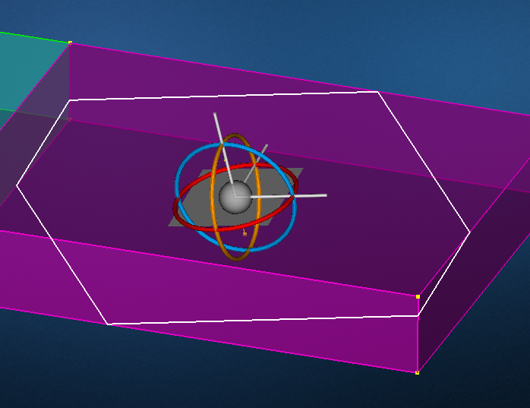
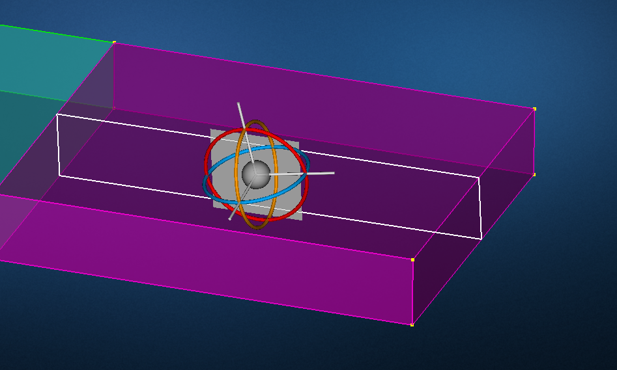
Then hit ‘R’ to change the manipulator to rotation mode
Pick on one of the rings and rotate the plane 90 degrees

Slide 3
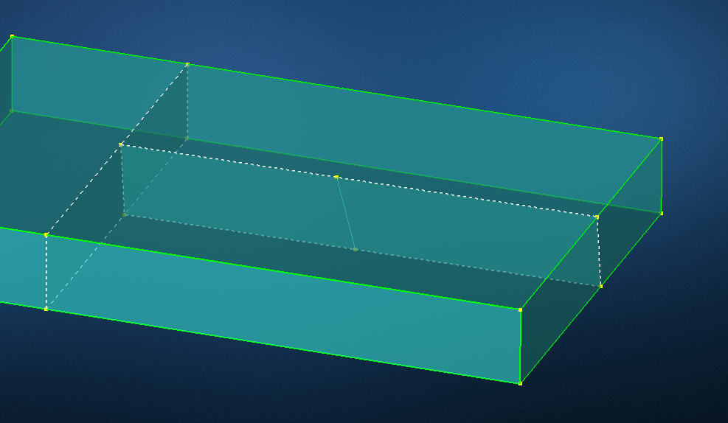
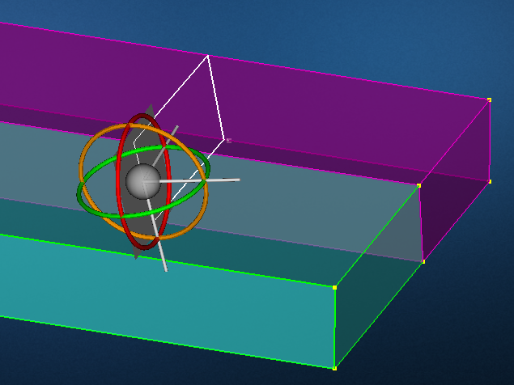
Split the cell using that plane
Repeat for one of the cells but split on the other plane:

Slide 4
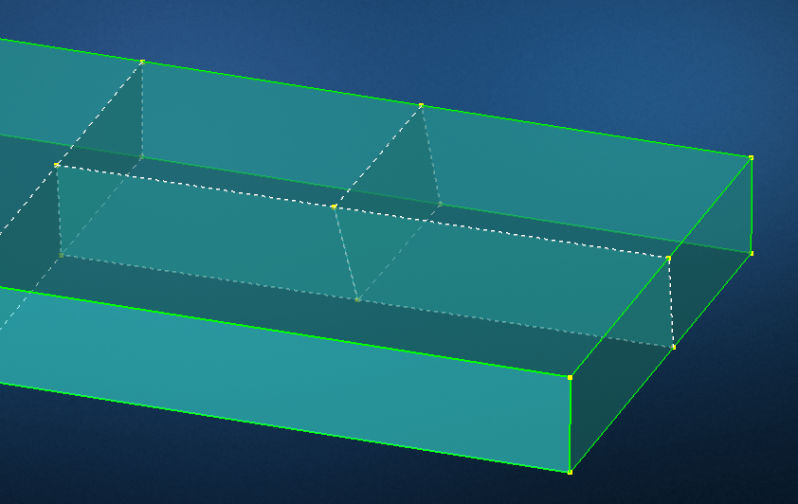
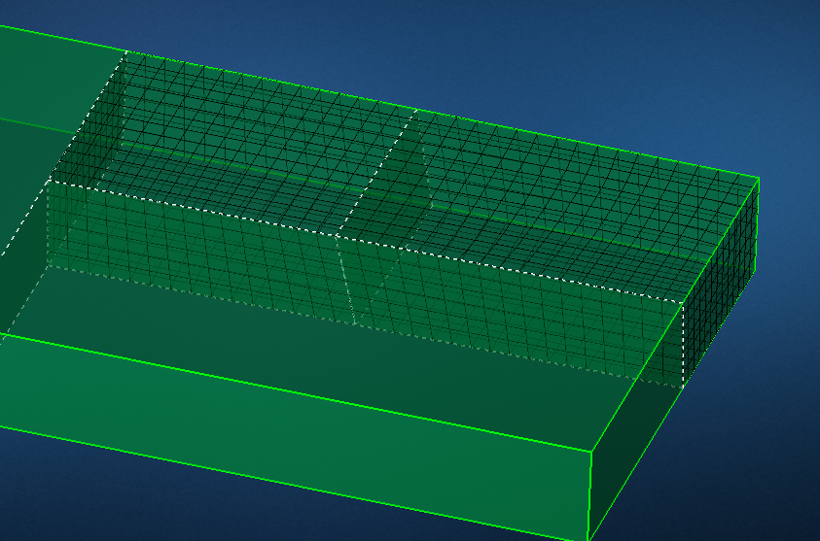
Now when you mesh you’ll have nodes aligned on the original curve:

