Slide 1
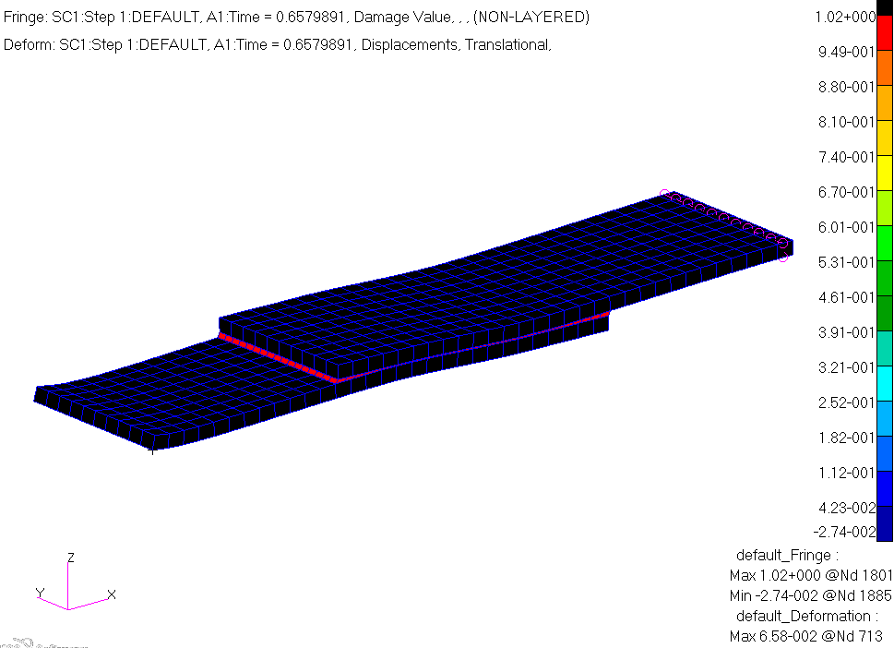
WORKSHOP
CZM – LAP-SHEAR JOINT

Slide 2
Workshop Objectives
Perform a CZM delamination analysis.
Create contact pairs.
Create cohesive material
Create interface elements.
Software Version
Patran 2019
MSC Nastran 2019
Required File:
build_shear_czm.ses

Slide 3
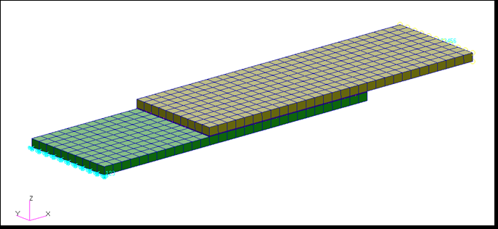
Problem Description
Two composite plates are glued together with a adhesive layer.
One end of the plates is fixed and pulling on the other end.
The exponential cohesive material model is used the interface elements.
G_{c} = 3.0 in-lb/in²
V_{c} = 0.0002
Pull
Composite Plates
Fixed
Cohesive Layer

Slide 4
Suggested Exercise Steps
Create a new database.
Play session file “build_shear_czm.ses.”
Review the model boundary conditions with the model tree.
Review the contact bodies in the model.
Review the composite material and layup.
Create the contact pairs.
Check Glued Contact
Master = plate_lower
Slave = interface
Repeat for the upper plate
Create cohesive material.
Select exponential for the Constitutive Model
Enter 3 for Cohesive Energy
Enter 0.0002 for displacement
Create cohesive interface element property for all wedge elements.
Set up the analysis job.
Implicit Nonlinear for Solution Type
Uncheck Permanent Gluing

Slide 5
Suggested Exercise Steps (Cont.)
Use an adaptive increment type with a maximum time step of 0.05
Output Nonlinear Stresses
Review the sts file.
Attach OP2 results file.
Plot interface damage.
Set all time increments to display Element Edges and show True Scale
Plot damage at Time = 0.6579891
Graph load vs. x-deflection curve of the independent node of the RBE2s to view the constraint forces at all time increments.

Slide 6
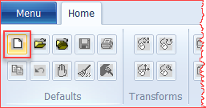
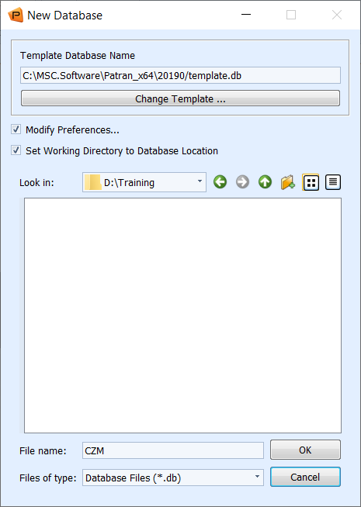
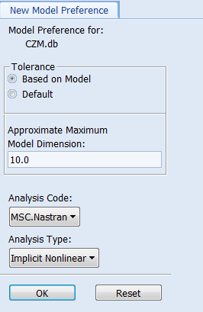
Step 1. Create a New Database
a
Create a new database called CZM:
Under the Home tab, click New in the Defaults group.
Enter CZM as the File name.
Click OK.
Select analysis type as Implicit Nonlinear.
Click OK.
d
b
c
e

Slide 7
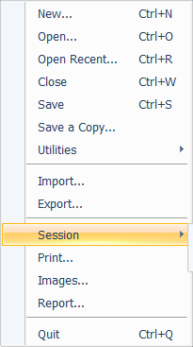
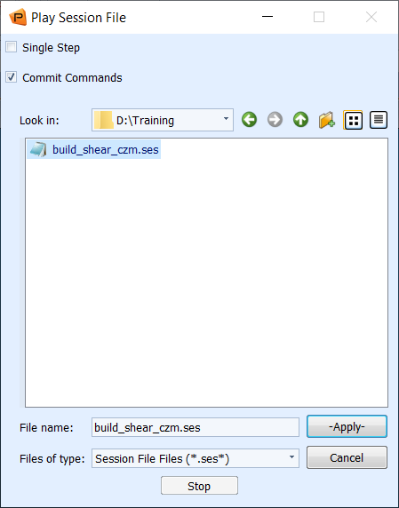
Step 2. Play Session File
Play session file:
Select File > Session > Play.
Select build_shear_czm.ses.
Click Apply.
a
b
c

Slide 8
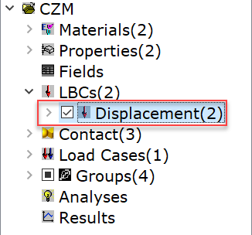
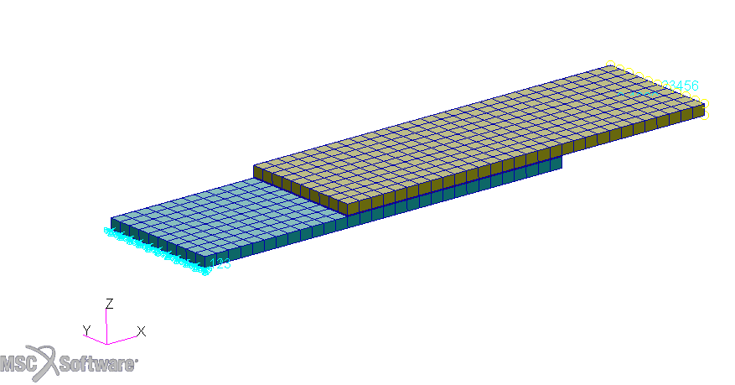
Step 3. Review the Model Boundary Conditions
a
Review the model boundary conditions with the model tree :
Under the Home tab, click Show/Hide Model Tree in the Model Tree group.
Expand LBCs and check the box next to Displacements.
Observe the loads and boundary conditions.
Uncheck when done reviewing the boundary conditions.
b
c

Slide 9
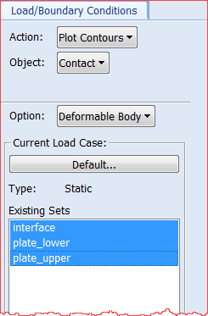
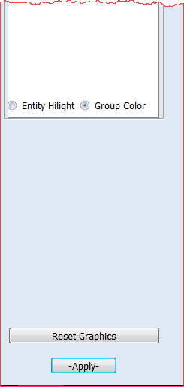
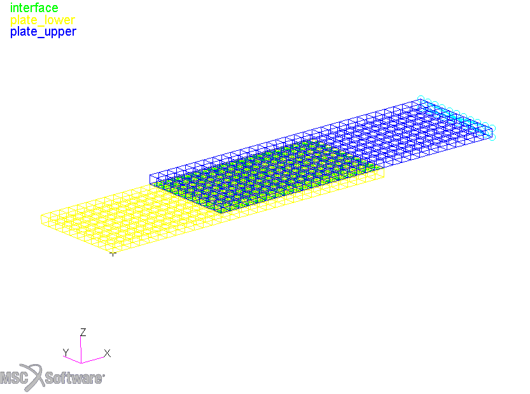
Step 4. Review the Model Contact Bodies
a
b
To review the contact bodies:
Under the Load/BCs tab, click Color Code Bodies in the Contact Bodies group.
Set Object to Contact.
Select all the Existing Sets.
Select Group Color.
Click Apply.
Observe the contact bodies.
Click on Reset Graphics.
c
d
f
g
e

Slide 10
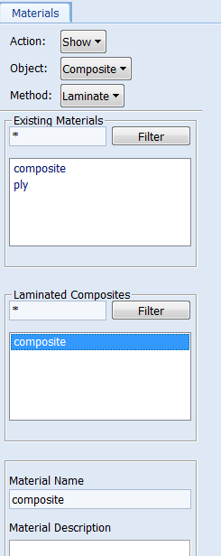
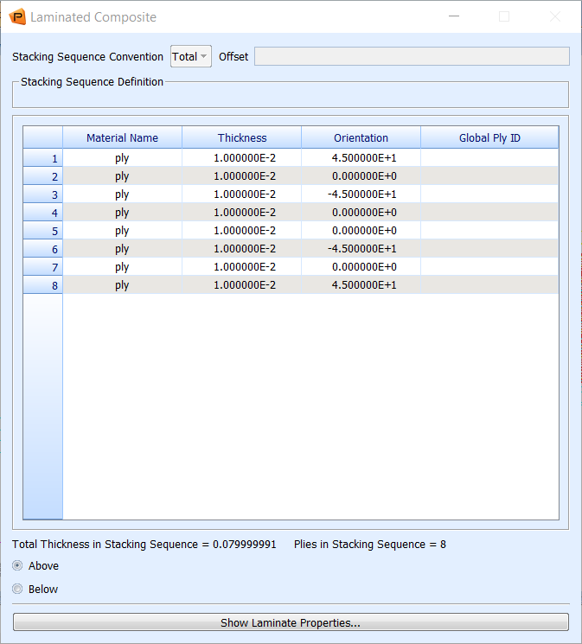
Step 5. Review Composite Material
a
b
c
To review the composite material:
Under the Materials tab, click Laminate from the Composite group.
Set Action to Show.
Set Object to Composite.
Select Composite from Laminated Composite.
Observe that the composite material has 8 layers.
e
d

Slide 11
Step 6. Create the Contact Pairs
a
To create the contact pairs:
Under the Loads/BCs tab, click Body Pair in the Body Pairs group.
Enter lower_glue for New Set Name.
Click Input Data.
Check the box for Glued Contact(IGLUE).
Click OK.
d
b
c
e

Slide 12
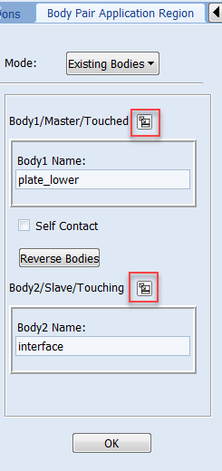
Step 6. Create the Contact Pairs (Cont.)
c
b
To create the contact pairs (cont.):
Click Select Application Region.
Click icon for Body1/Master/Touched and click plate_lower.
Click icon for Body2/Slave/Touching and click interface.
Click OK.
Click Apply.
b
c
d
a
e

Slide 13
Step 6. Create the Contact Pairs (Cont.)
To create the contact pairs (cont.):
Enter upper_glue for New Set Name.
Click Input Data.
Check the box for Glued Contact(IGLUE).
Click OK.
c
a
b
d

Slide 14
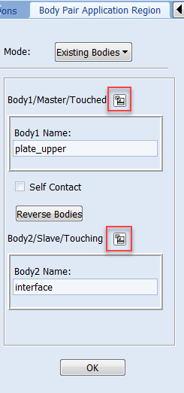
Step 6. Create the Contact Pairs (Cont.)
To create the contact pairs (cont.):
Click Select Application Region.
Click icon for Body1/Master/Touched and click plate_upper.
Click icon for Body2/Slave/Touching and click interface.
Click OK.
Click Apply.
c
b
b
c
a
e

Slide 15
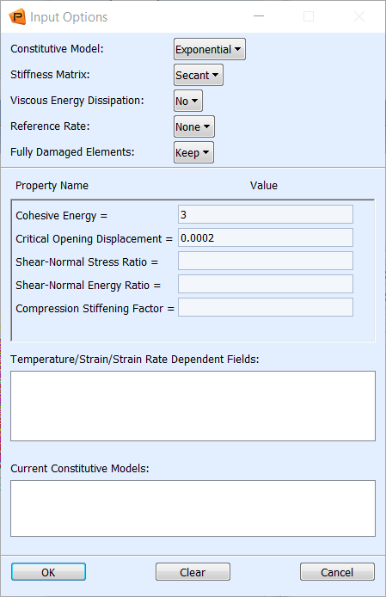
Step 7. Create Cohesive Material
a
d
To create cohesive material:
Under the Material tab, click Cohesive.
Enter Material Name cohesive.
Click Input Properties.
Select Exponential for Constitutive Model.
Enter 3 for Cohesive Energy.
Enter 0.0002 for Critical Opening Displacement.
Click OK.
Click Apply.
e
f
b
c
g
h

Slide 16
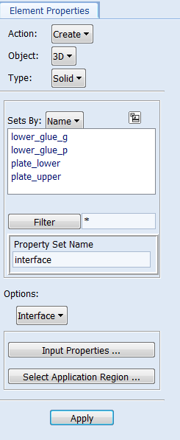
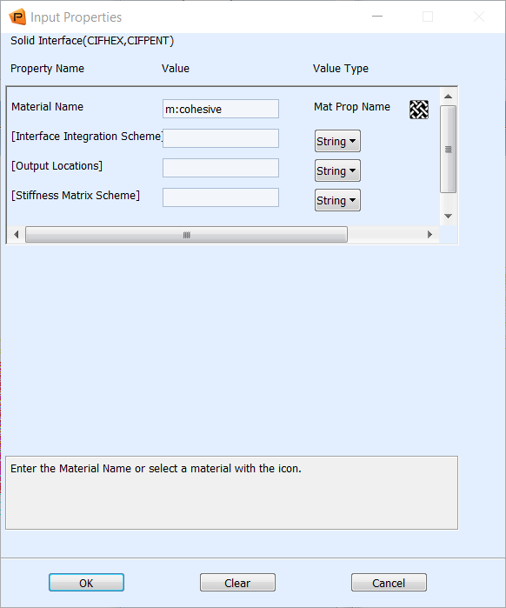
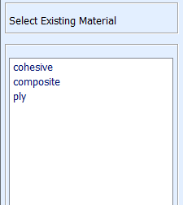
Step 8. Create Interface Element Property
a
To create cohesive interface element property:
Under the Properties tab, click Solid.
Enter Property Set Name interface.
Select Interface option.
Click Input Properties.
Click material icon.
Select cohesive.
Click OK.
e
b
f
c
d
h
g

Slide 17
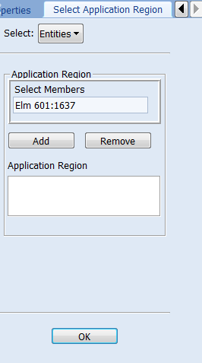
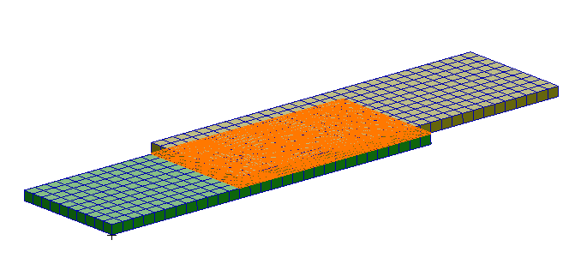
Step 8. Create Interface Element Property (Cont.)
To create cohesive interface element property (cont.):
Click Select Application Region.
Select Wedge Element filter.
Select all wedge elements.
Click Add.
Click OK.
Click Apply.
b
d
e
a
c
f

Slide 18
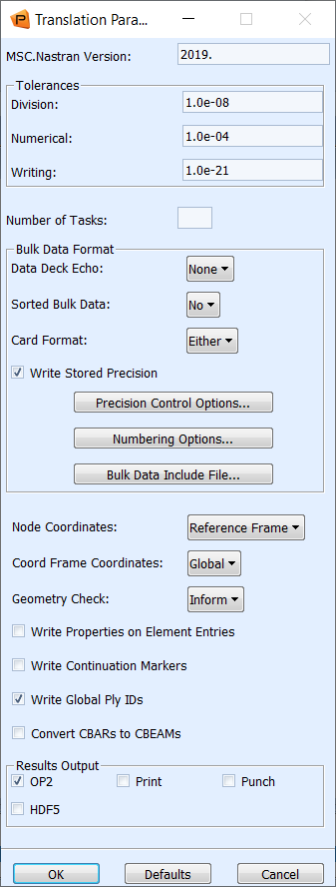
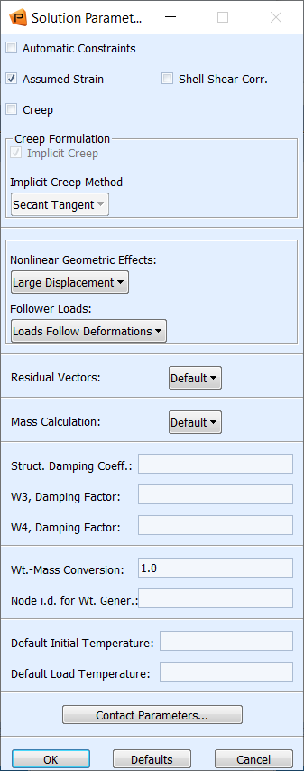
Step 9. Set up the Analysis Job
a
Set up job parameters:
Under the Analysis tab, click Entire Model in the Analyze group.
Click Translation Parameters
Uncheck Print.
Select OP2.
Click OK.
Click Solution Parameters.
Click Contact Parameters.
b
f
d
c
g
e

Slide 19
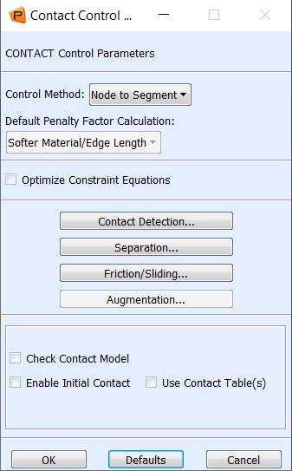
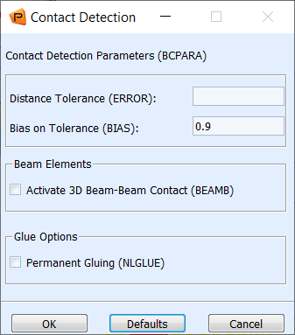
Step 9. Set up the Analysis Job (Cont.)
Set up job parameters (cont.):
Click Contact Detection.
Uncheck Permanent Gluing (NLGLUE).
Click OK.
Click OK.
a
b
c
d

Slide 20
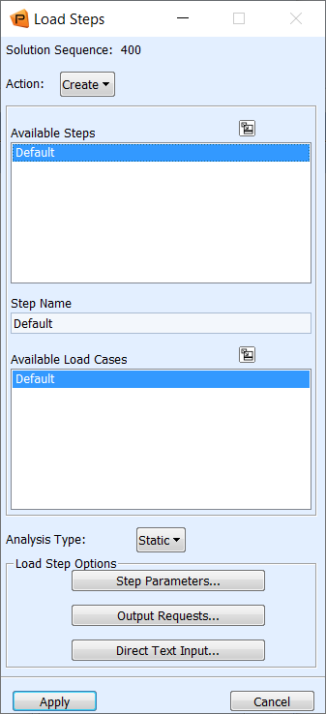
Step 9. Set up the Analysis Job (Cont.)
Set up job parameters (cont.):
Click Load Steps..
Select Default under Available Subcases.
Click Step Parameters.
b
c
a

Slide 21
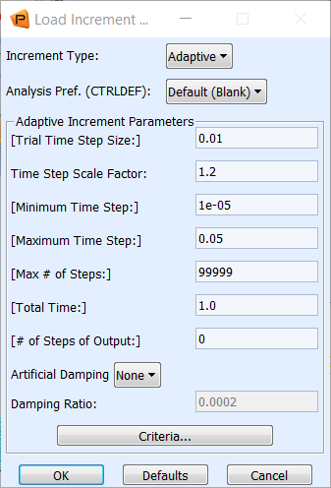
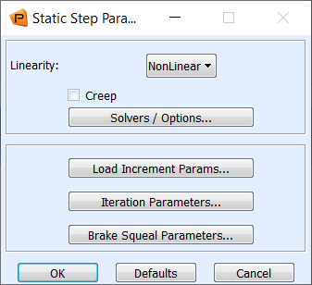
Step 9. Set up the Analysis Job (Cont.)
b
Set up job parameters (cont.):
Click Load Increment Params.
Select Adaptive for Increment Type.
Enter 0.05 for Maximum Time Step.
Click OK.
Click OK.
Click Output Requests.
a
c
e
d
f

Slide 22
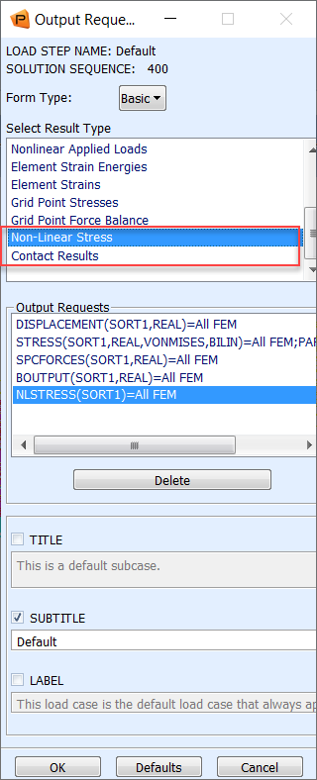
Step 9. Set up the Analysis Job (Cont.)
Set up job parameters (cont.):
Select Non-Linear Stress and Contact Results under Select Result Type.
Click OK.
Click Apply.
Click Cancel.
Click Apply.
a
c
d
b
e

Slide 23
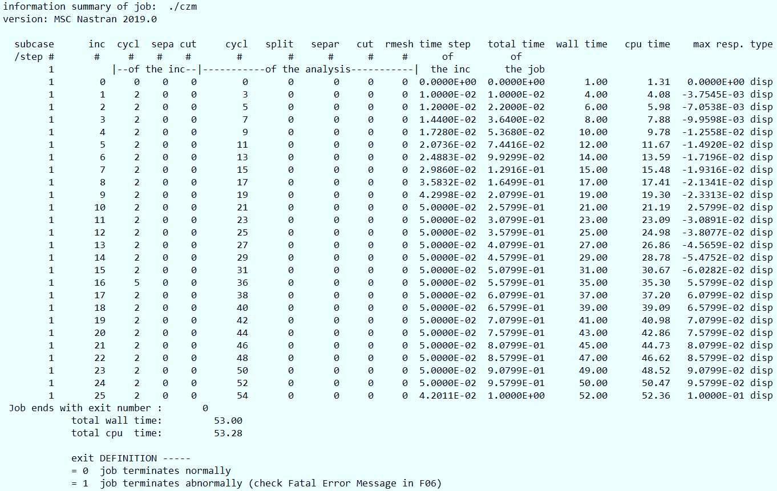
Step 10. Review the sts Files
Open CZM.sts file to check the job status – normal completion if job ends with exit number 0.
a

Slide 24
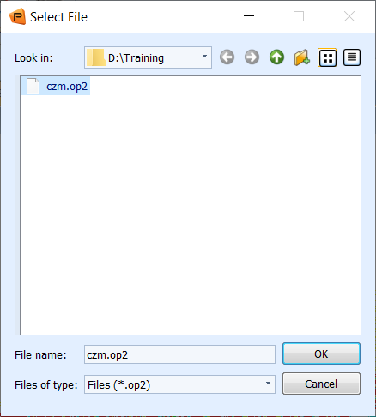
Step 11. Attach OP2 Results File
a
Attach Results file:
Under the Analysis tab, click the Output2 in the Access Results group.
Click Select Results File.
Browse to the working directory and select czm.op2
Click OK.
Click Apply.
c
d
b
e

Slide 25
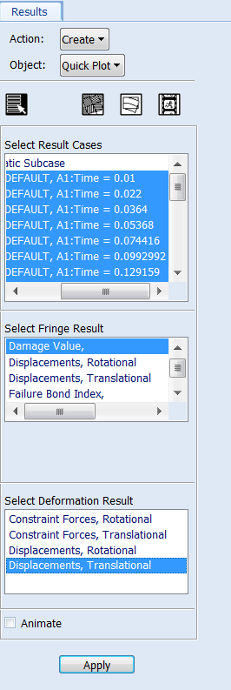
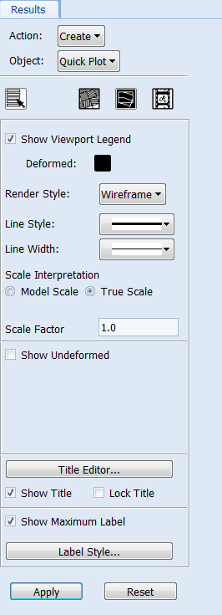
Step 12. Plot Interface Damage
a
g
e
To plot interface damage:
Under the Results tab, click Fringe/Deformation in the Quick Plot group.
Under the Select Result Cases, select all increments except the first one.
Select Damage Value under Select Fringe Result.
Select Displacements, Translational under Select Deformation Result.
Click the Fringe Attributes icon.
Select Element Edges for Display.
Click the Deform Attributes icon.
Select True Scale.
Uncheck Show Undeformed.
Click Apply.
b
h
c
i
f
d
j

Slide 26
Step 12. Plot Interface Damage (Cont.)
a
Plot interface damage at specified time:
Under the Results tab, click Fringe/Deformation in the Quick Plot group.
Select results case at Time = 0.6579891 under Select Result Cases.
Select Damage Value under Select Fringe Result.
Select Displacements, Translational under Select Deformation Result.
Click Apply.
b
c
d
e

Slide 27
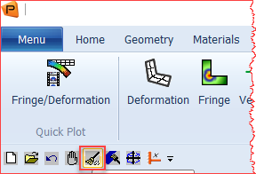
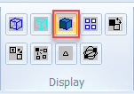
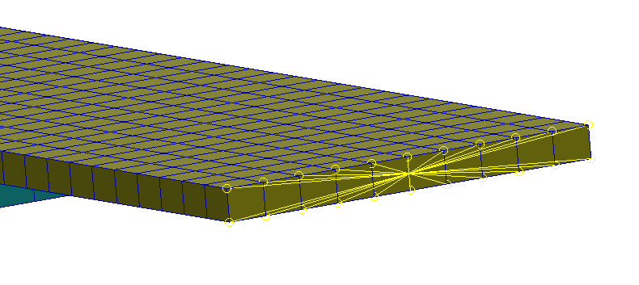
Step 13. Graph Load-Deflection Curve
a
b
Graph load-deflection curve:
Click Reset Graphics.
Under the Home tab, click Smooth shaded in the Display group.
Zoom in to the right edge of the top plate.
c

Slide 28
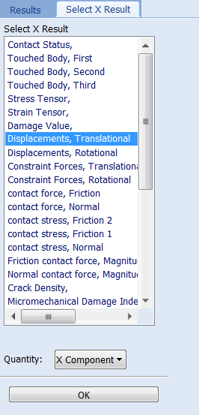
Step 13. Graph Load-Deflection Curve (Cont.)
a
b
Graph load-deflection curve of the independent node of the RBE2s:
Change the Object to Graph.
Change the Method the Y vs X.
Under the Select Result Cases, select all increments except the first one.
Select Constraint Forces Translational under Select Y Result.
Pull down Quantity to X Component.
Pull down X to Result.
Click Select X Result.
Select Displacements, Translational under Select X Result.
Pull down Quantity to X Component.
Click OK.
c
h
d
e
i
f
g
j

Slide 29
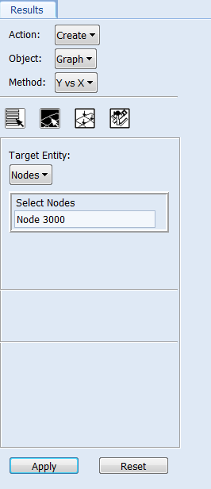
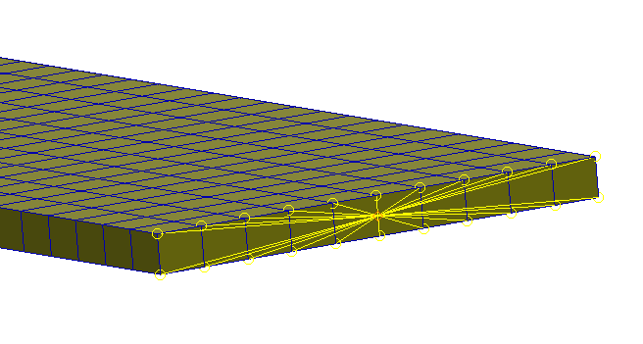
Step 13. Graph Load-Deflection Curve (Cont.)
a
Graph load-deflection curve (cont.):
Click the Target Entities icon.
For the Target Entity select Nodes.
Select the Node highlighted in the image or enter Node 3000 in the Select Nodes box.
Click Apply.
b
c
d
c

Slide 30
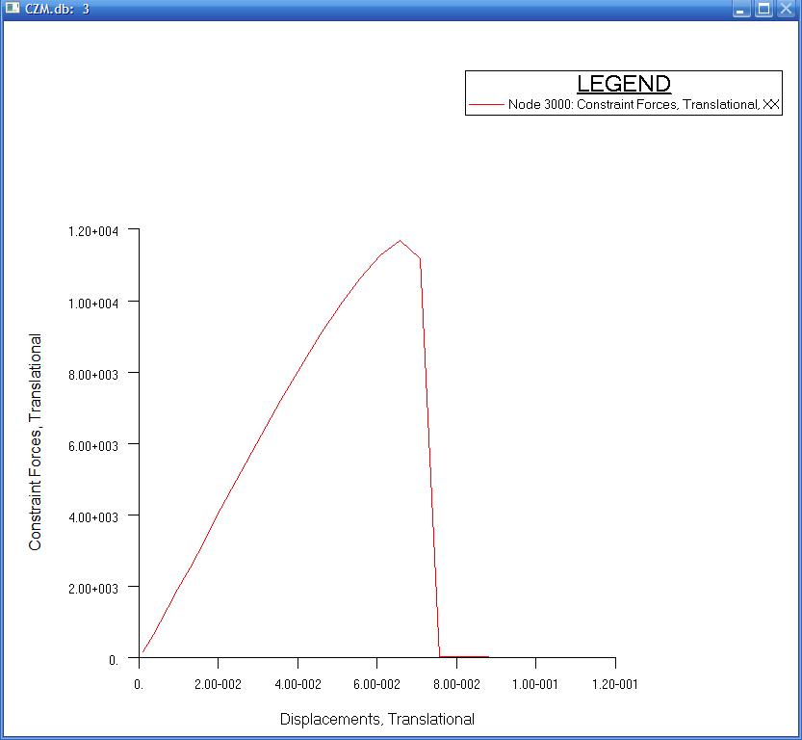
Step 13. Graph Load-Deflection Curve (Cont.)

