Slide 1
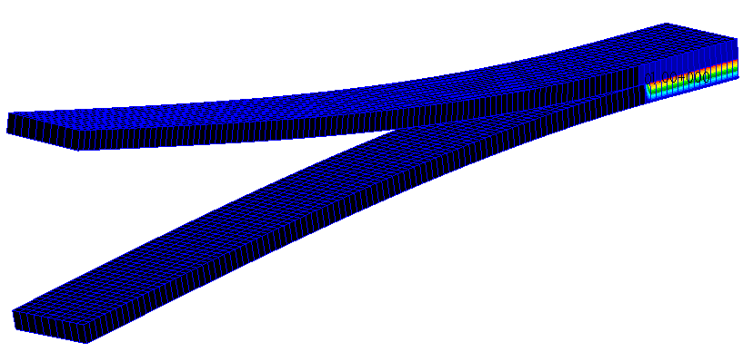
WORKSHOP
VCCT – DOUBLE CANTILEVER BEAM

Slide 2
Workshop Objectives
Perform a VCCT analysis on DCB.
Review boundary conditions and contact bodies.
Edit input file to add VCCT entries.
Post process results.
Software Version
Patran 2019
MSC Nastran 2019
Required File:
build_dcb_vcct.ses

Slide 3
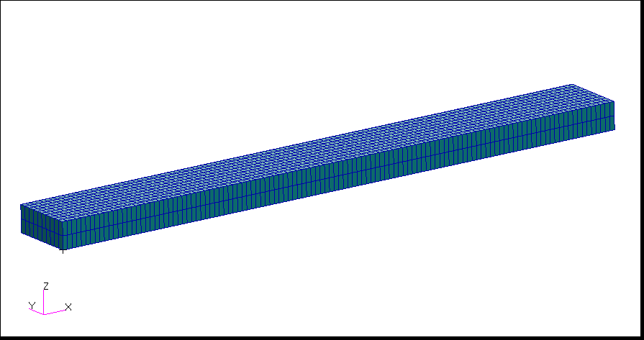
Problem Description
Two composite cantilever beams are glued together with initial crack.
One end of the beams is fixed and the other is forced to separate.
This is a Mode I crack propagation, fracture toughness is set to 1.2.
Fixed
Open
Crack Front
Glued Contact

Slide 4
Suggested Exercise Steps
Create a new database.
Play session file “build_dcb_vcct.ses.”
Review the model boundary conditions.
Review the contact bodies in the model.
Review the model material and layup.
Create the contact pairs.
Check Glued Contact
Master = bottom_region
Slave = top_region
Post a new group “top_contact.”
Define crack front and setup VCCT parameters.
Change Crack Propagation to Direct
Enter 1.2 for C.G Increment Size
Select bottom left edge nodes of the plate
Post entire model
Set up and run an implicit nonlinear solution type. Turn off permanent gluing. Use Adaptive for Increment Type. Select Default subcase. Output Nonlinear Stresses and Contact Results.

Slide 5
Suggested Exercise Steps (Cont.)
Review the sts file.
Attach OP2 results file.
Plot contact status superimposed on the deformed shape for all nonlinear subcases. Use True Scale for the deformation.
Graph load vs. z-deflection for the node where the upward enforced displacement is applied.

Slide 6
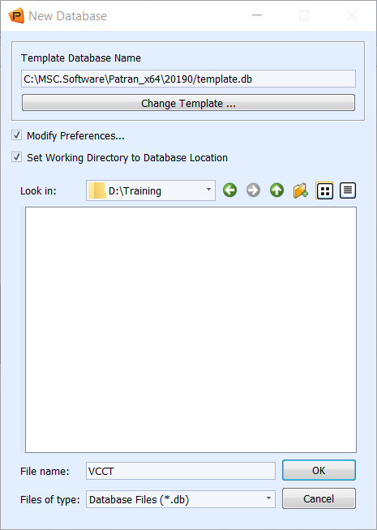
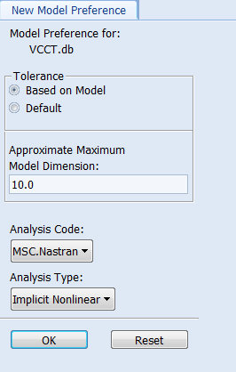
Step 1. Create a New Database
a
Create a new database called VCCT:
Under the Home tab, click New in the Defaults group.
Enter VCCT as the File name.
Click OK.
Select analysis type as Implicit Nonlinear
click OK.
d
b
c
e

Slide 7
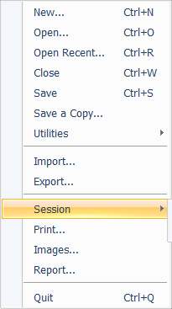
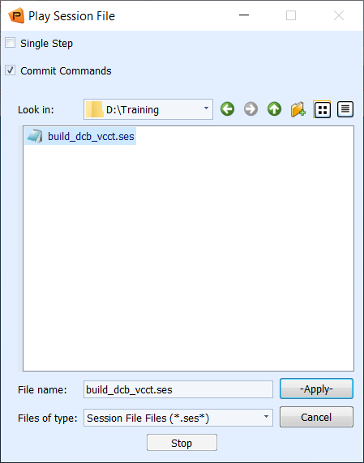
Step 2. Play Session File
Play session file:
Pull down File > Session > Play.
Select build_dcb_vcct.ses.
Click Apply.
a
b
c

Slide 8
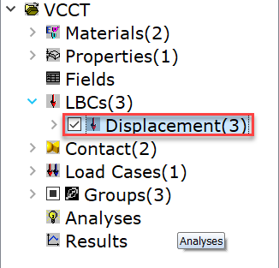
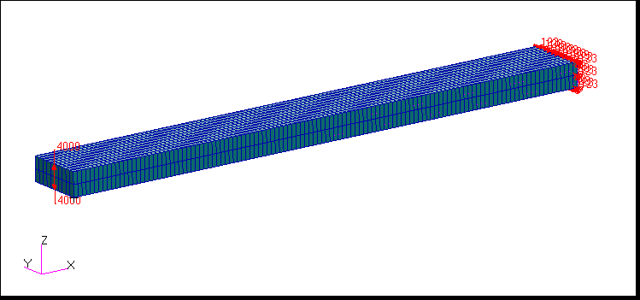
Step 3. Review the Model Boundary Conditions
a
To review the model boundary conditions:
Under the Home tab, click Show/Hide Model Tree in the Model Tree group.
Expand LBCs and check the box next to Displacements.
Observe the loads and boundary conditions.
Uncheck when done reviewing the boundary conditions.
b
c

Slide 9
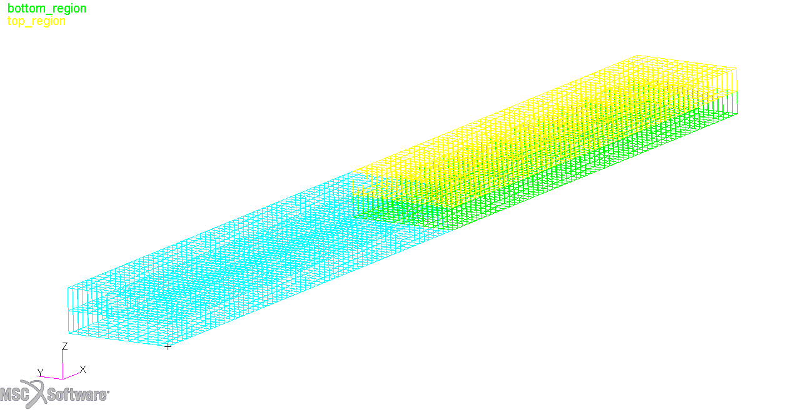
Step 4. Review the Contact Bodies in the Model
a
To review the contact bodies:
Under the Load/BCs tab, click Color Code Bodies in the Contact Bodies group.
Select both Existing Sets.
Click Apply.
Observe the contact bodies.
b
d
c

Slide 10
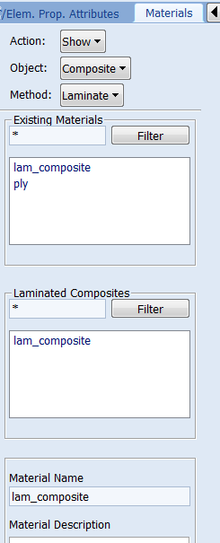
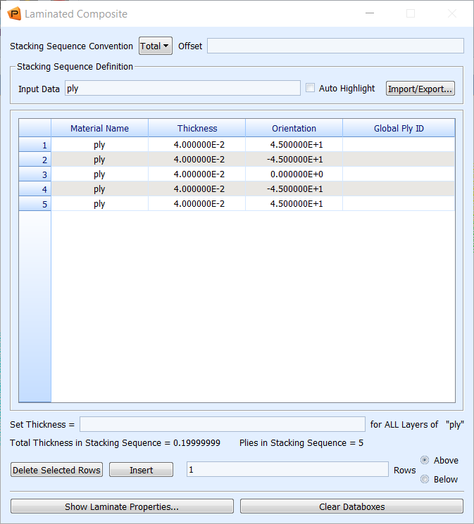
Step 5. Review the Model Material
b
c
a
d
To review the material used in the model:
Under the Materials tab, click Laminate in the Composite group.
For Action select Show.
For Object select Composite.
For Method select Laminate.
Click on the material lam_composite.
Observe the composite plies.
f
e

Slide 11
Step 6. Create the Contact Pairs
a
To create the contact pairs:
Under the Loads/BCs tab, click Create Body Pair in the Body Pairs group.
Enter glue for New Set Name.
Click Input Data.
Check the box for Glued Contact(IGLUE).
Click OK.
d
b
c
e

Slide 12
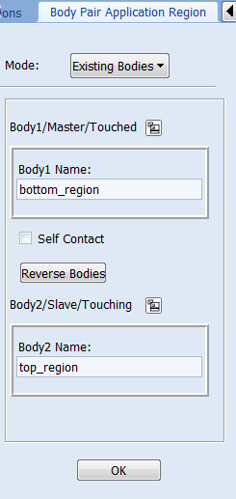
Step 6. Create the Contact Pairs (Cont.)
d
b
f
Select the application region:
Click Select Application Region.
Leave Mode as Existing Bodies.
Click the icon for Body1/Master/Touched.
Select bottom_region.
Click the icon for Body2/Master/Touching.
Select top_region.
Click OK.
Click Apply.
c
e
g
a
h

Slide 13
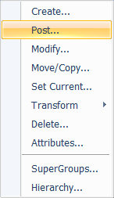
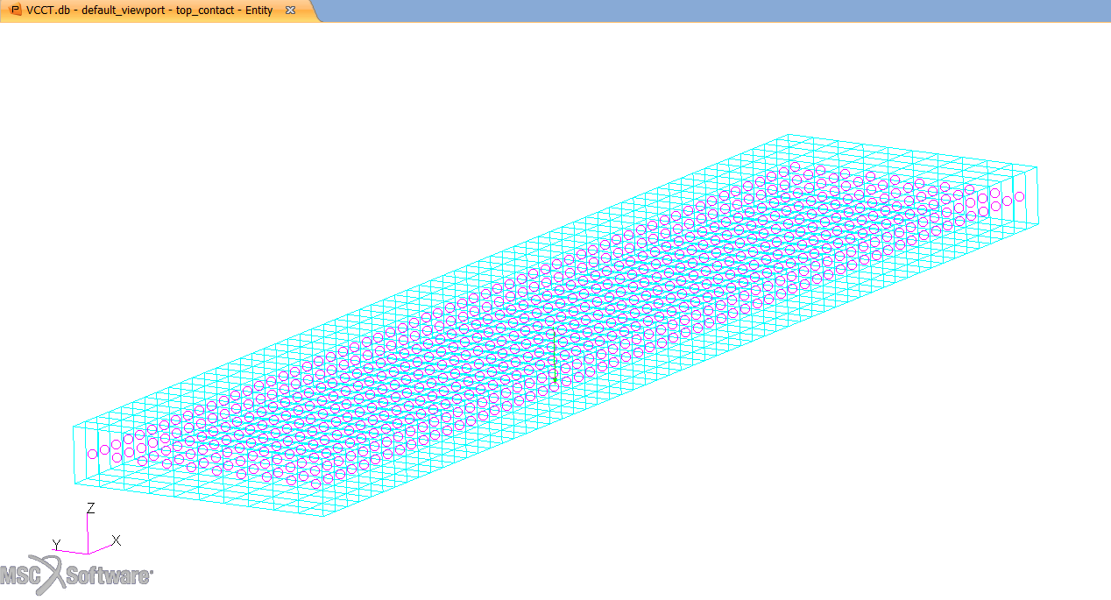
Step 7. Post a New Group
Pull down Group > Post.
Select top_contact under Select Groups to Post.
Click Apply.
Click Cancel.
Review the group that is posted.
a
b
e
c
d

Slide 14
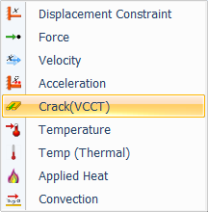
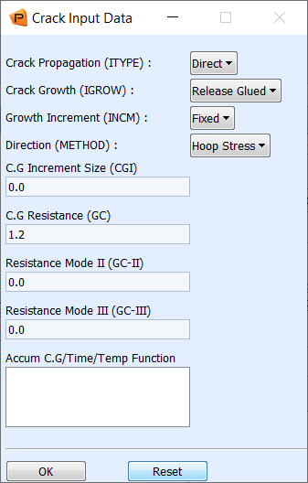
Step 8. Define Crack and Setup VCCT Parameters
d
a
To define crack front and setup VCCT parameters:
Under the Loads/BCs tab, click on Crack(VCCT) in the Nodal group.
Enter crack for New Set Name.
Click Input Data.
Pull down Direct for Crack Propagation (ITYPE).
Enter 1.2 for C.G Resistance (GC).
Click OK.
e
b
c
f

Slide 15
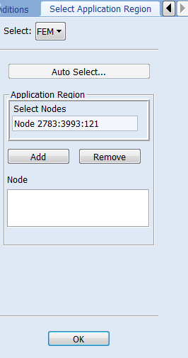
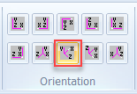
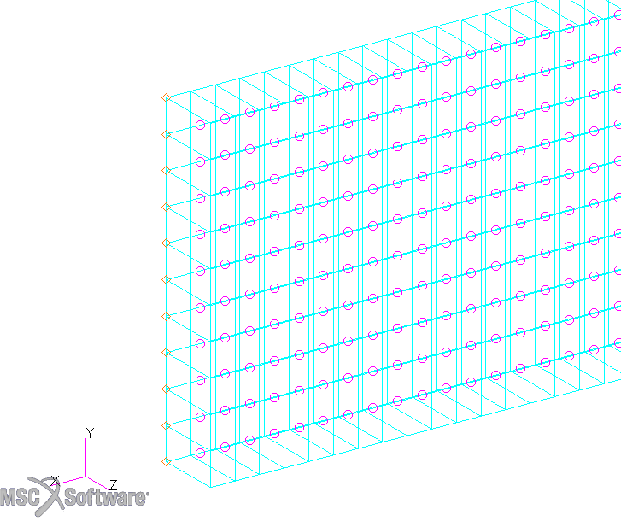
Step 8. Define Crack and Setup VCCT Parameters (Cont.)
b
To define crack front and setup VCCT parameters (cont.):
Click Select Application Region.
Pull down Select to FEM.
Under the Home tab, click Iso 2 View in the Orientation group.
Zoom in to the left edge of the plate and click in the Select Nodes box.
Select the bottom left edge nodes.
Click Add.
Click OK.
Click Apply.
d
c
f
g
e
a
h

Slide 16
Step 8. Define Crack and Setup VCCT Parameters (Cont.)
a
Post the entire model:
Pull down Group > Post.
Click default_group under Select Groups to Post.
Click Apply.
Click Cancel.
b
c
d

Slide 17
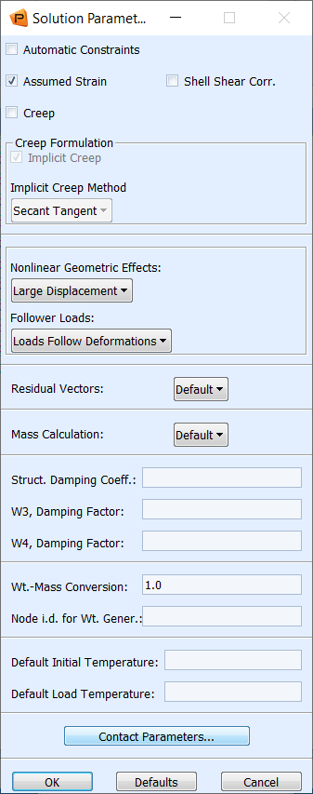
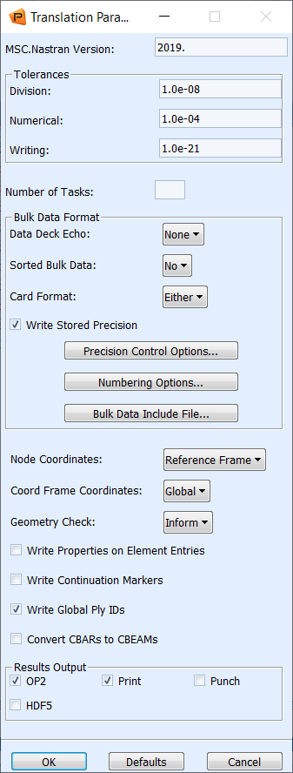
Step 9. Set up the Analysis Job
a
Set up parameters:
Under the Analysis tab, click Entire Model in the Analyze group.
Click Translation Parameters.
Select OP2.
Click OK.
Click Solution Parameters.
Click Contact Parameters.
f
b
e
c
d

Slide 18
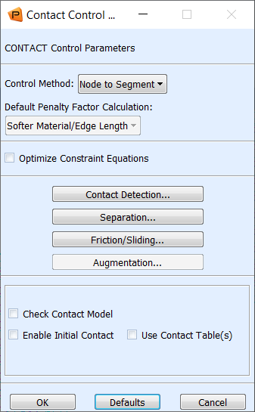
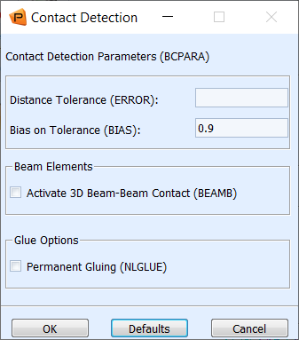
Step 9. Set up the Analysis Job (Cont.)
Set up parameters (cont.):
Click Contact Detection.
Uncheck Permanent Gluing (NLGLUE).
Click OK.
Click OK.
a
b
c
d

Slide 19
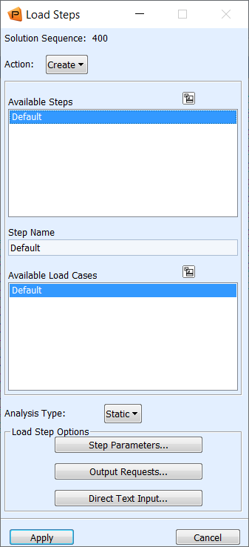
Step 9. Set up the Analysis Job (Cont.)
Set up parameters (cont.):
Click Load Steps
Click Default under Available Subcases.
Click Step Parameters.
b
c
a

Slide 20
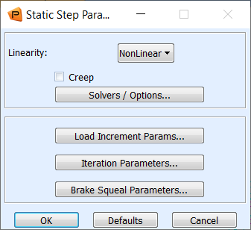
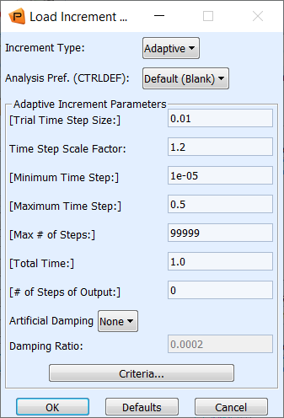
Step 9. Set up the Analysis Job (Cont.)
Set up parameters (cont.):
Click Step parameters.
Click Load Increament parameters.
Pull down Adaptive for Increment Type.
Click OK.
Click OK.
Click Output Requests.
c
b
e
a
f
d

Slide 21
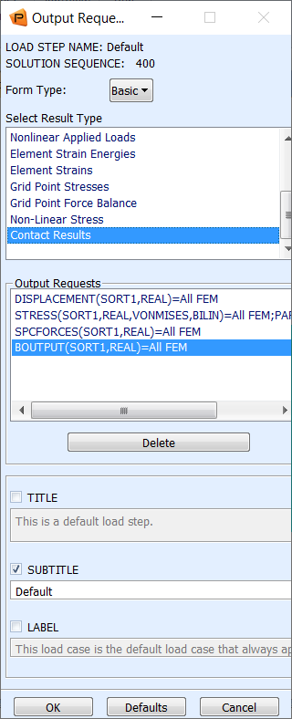
Step 9. Set up the Analysis Job (Cont.)
Set up parameters (cont.)
Select to output Nonlinear stresses and contact results:
Click Non-Linear Stress and Contact Results under Select Result Type.
Click OK.
Click Apply.
Click Cancel.
Click Apply.
a
c
d
b
e

Slide 22
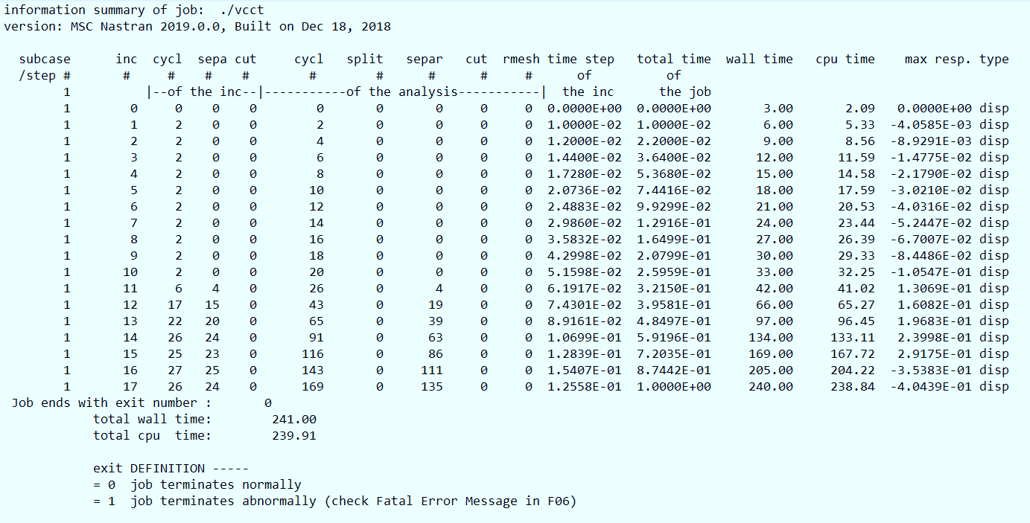
Step 10. Review the sts File
Open VCCT.sts file to check the job status.
Normal completion of job ends with exit number 0.
a
b

Slide 23
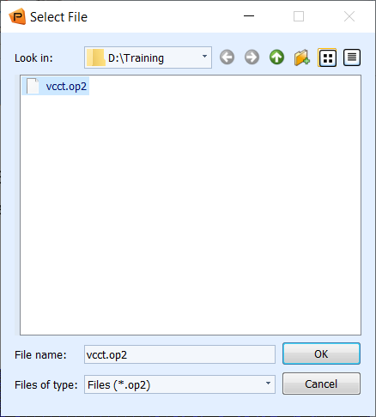
Step 11. Attach OP2 Results File
a
Access Results file:
Under the Analysis tab, click Output2 in the Access Results group.
Click Select Results File.
Browse to the working directory and select vcct.op2.
Click OK.
Click Apply.
c
b
d
e

Slide 24
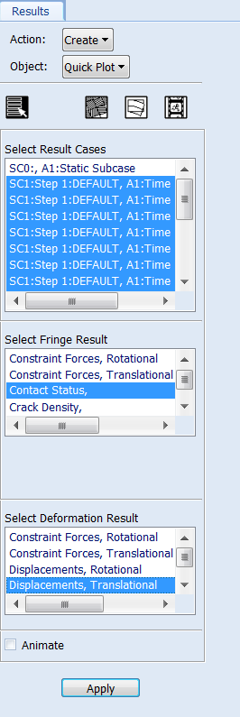
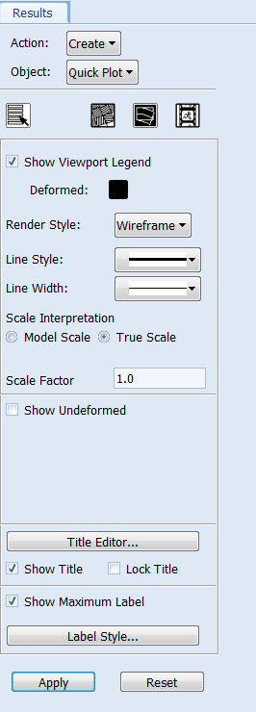
Step 12. Plot Contact Status
a
e
g
Plot contact status:
Under the Results tab, click on Fringe/Deformation in the Quick Plot group.
Under Select Result Cases select all increments except SC0:, A1:Static Subcase.
Select Contact Status under Select Fringe Result.
Select Displacement Translational under Select Deformation Result.
Click Fringe Attributes icon.
Pull down Element Edges for Display.
Click Deform Attributes icon.
Select True Scale.
Uncheck Show Undeformed.
Click Apply.
b
h
c
i
f
d
j

Slide 25
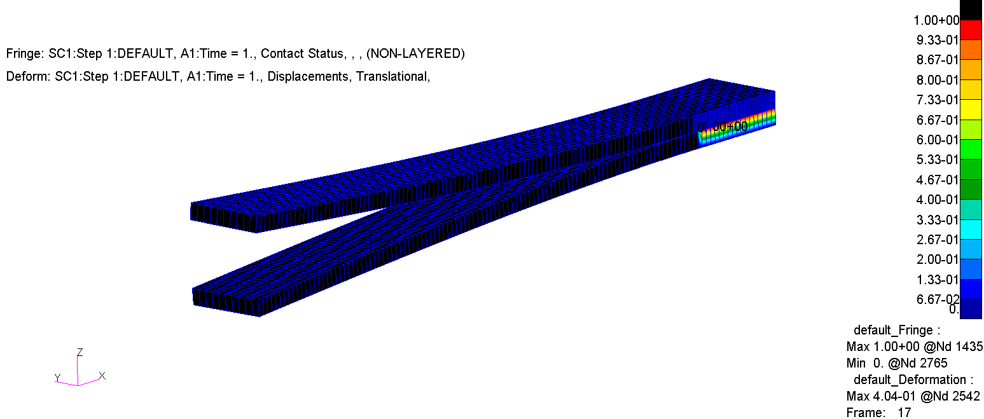
Step 12. Plot Contact Status (Cont.)

Slide 26
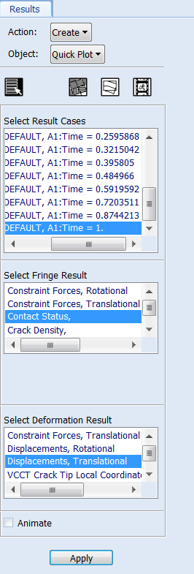
Step 12. Plot Contact Status (Cont.)
a
Plot contact status (cont.):
Under the Results tab, click Fringe/Deformation in the Quick Plot group.
Select the last result case (Time = 1) under Select Result Case.
Select Contact Status under Select Fringe Result.
Select Displacements, Translational under Select Deformation Result.
Click Apply.
b
c
d
e

Slide 27
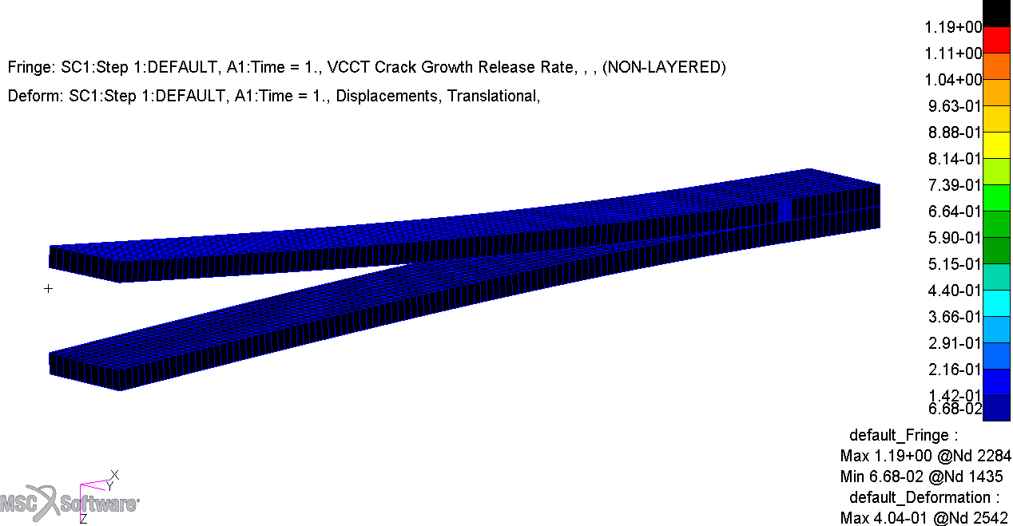
Step 12. Plot Contact Status (Cont.)
If interested, you can plot VCCT Crack Growth Release Rate.

Slide 28
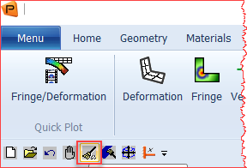
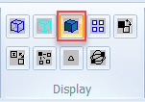
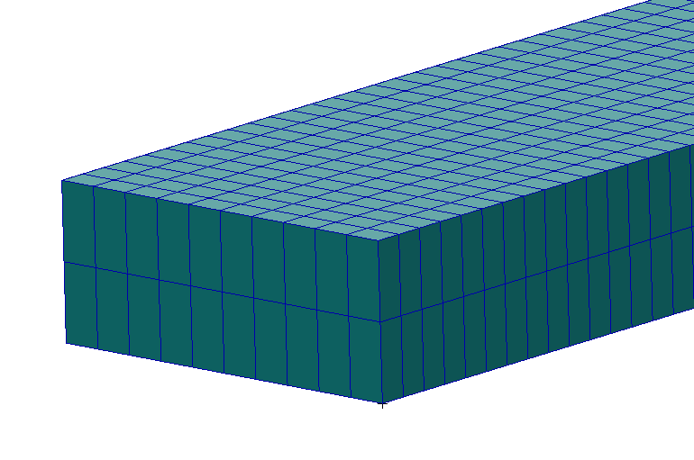
Step 13. Graph Load-Deflection Curve
a
Set up model to graph the load-deflection curve:
Click Reset Graphics.
Under the Home tab, click Smooth shaded in the Display group.
Zoom into the left edge of the plates.
b
c

Slide 29
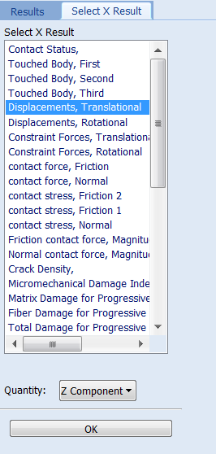
Step 13. Graph Load-Deflection Curve (Cont.)
a
Graph the load-deflection curve:
Under the Results tab, click Graph from the Result Plots group.
Under the Select Result Cases select all the increments except SC0:, A1:Static Subcase.
Select Constraint Forces, Translational under Select Y Result.
Pull down Z Component for Quantity.
Pull down Result for X.
Click Select X Result.
Select Displacements, Translational under Select X Result.
Pull down Z Component for Quantity.
Click OK.
g
b
c
d
e
h
f
i

Slide 30
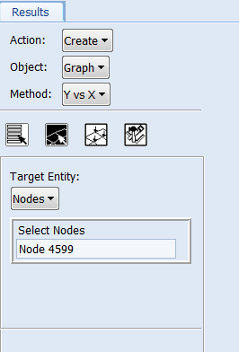
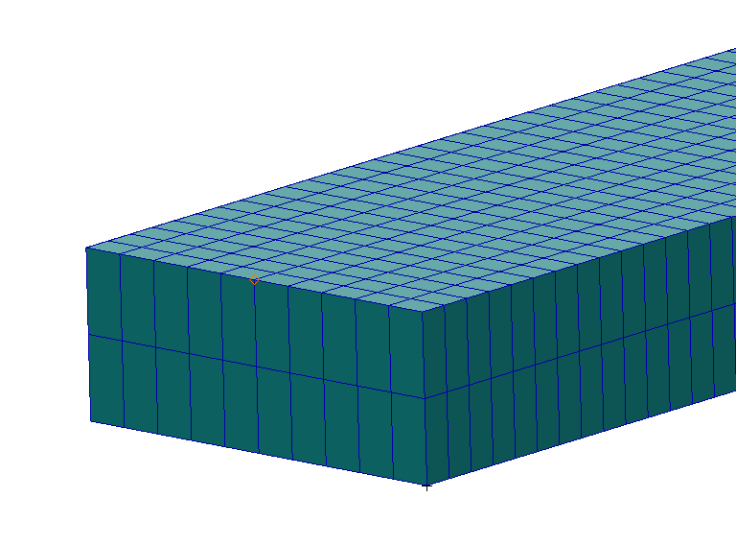
Step 13. Graph Load-Deflection Curve (Cont.)
Graph the load-deflection curve (cont.):
Click the Target Entities icon.
For Target Entity select Nodes.
Select the Node highlighted in the image or enter Node 4599 in the Select Nodes box.
Click Apply.
a
b
c
d

Slide 31
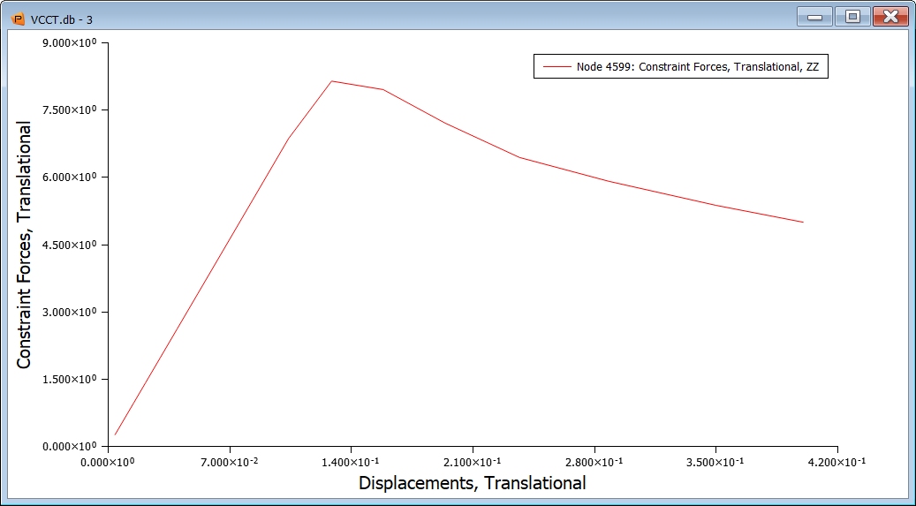
Step 13. Graph Load-Deflection Curve (Cont.)

