Slide 1
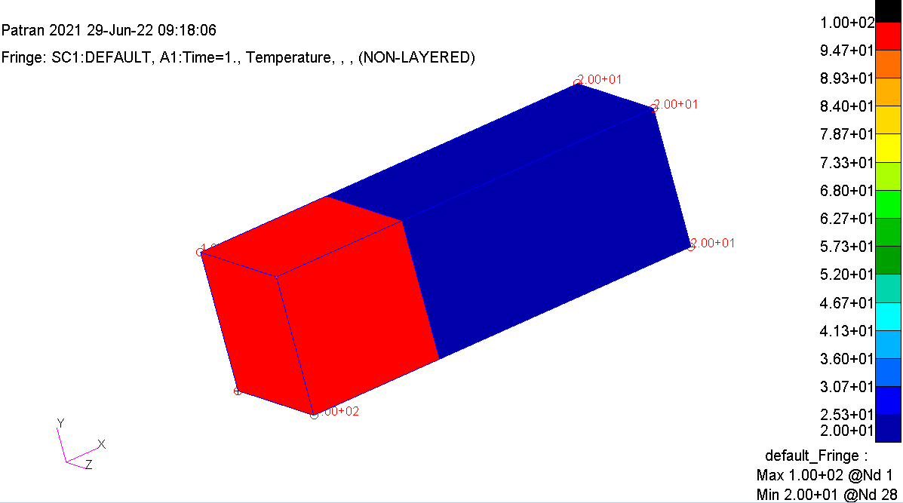
Not connected

Slide 2
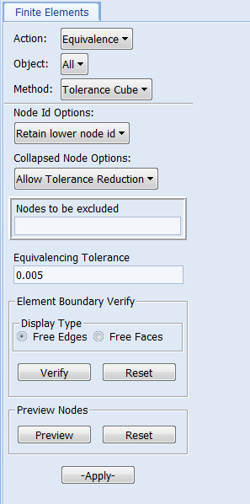
Merge the nodes at interface

Slide 3
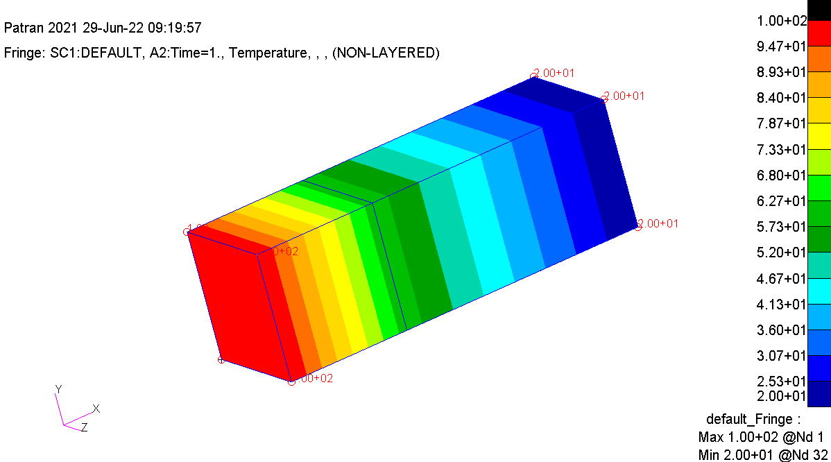
Merge the nodes at the interface

